Slide 1
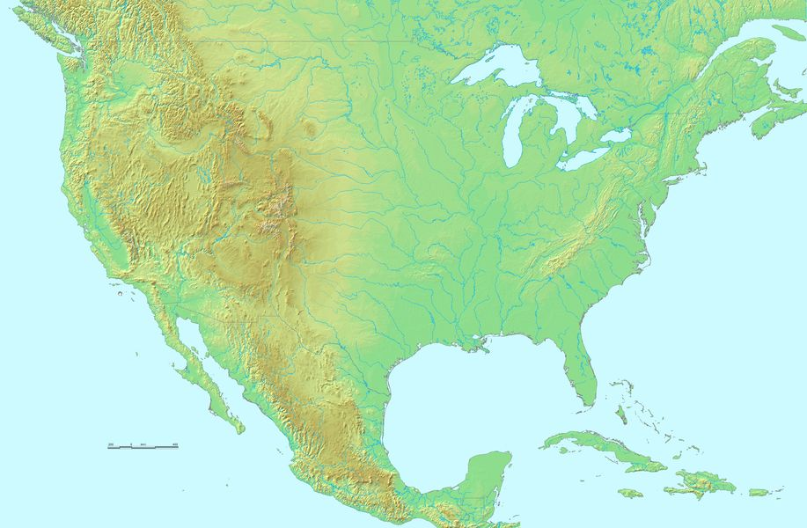
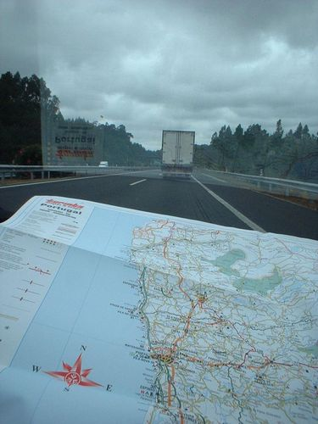
Maps help people understand the world.
Maps are pictures with information about places.

Slide 2
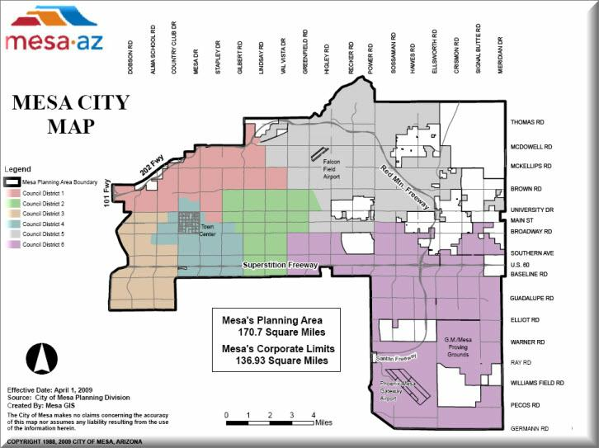
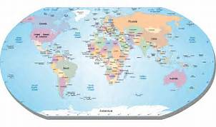
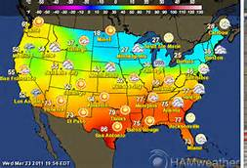
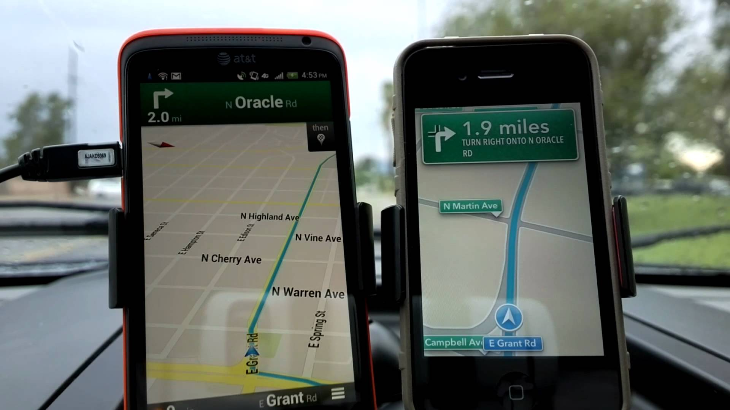
There are many different kinds of maps.

Slide 3
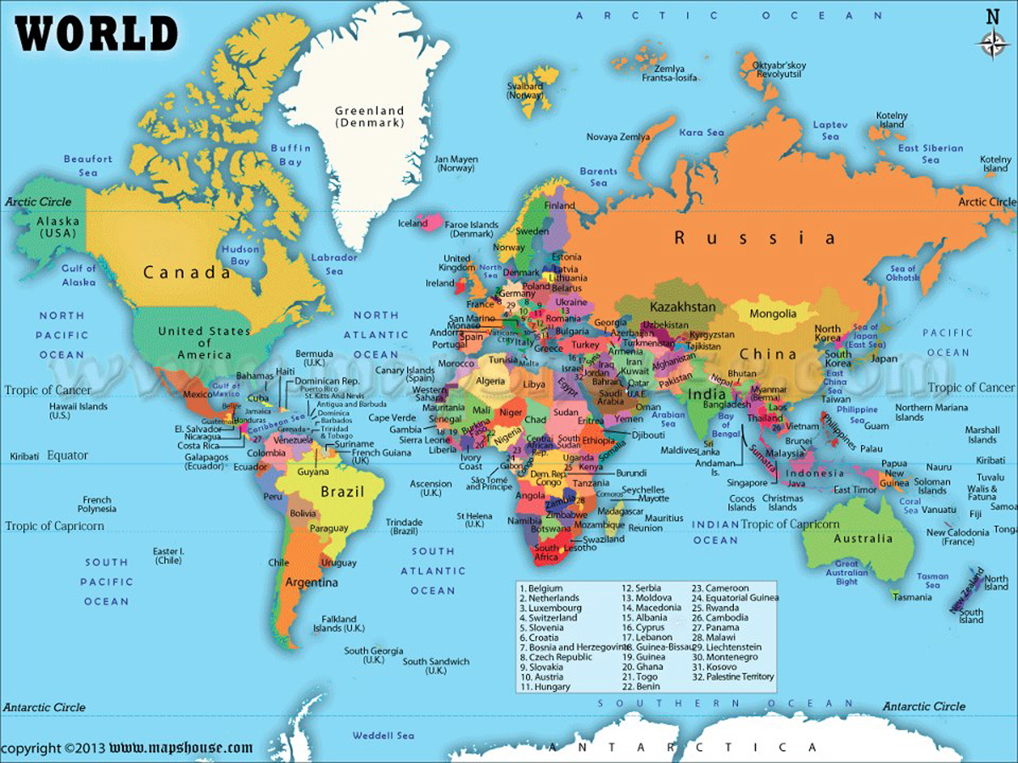
A world map shows where places are on Earth.
It shows the continents and their parts.

Slide 4
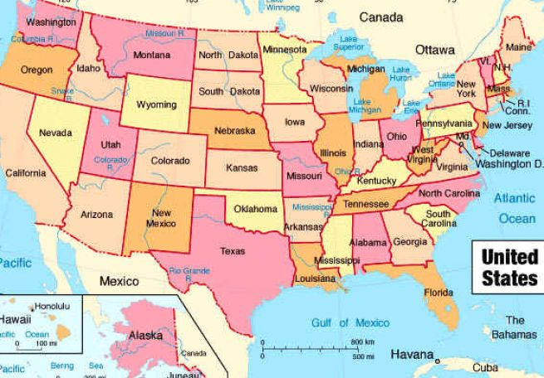
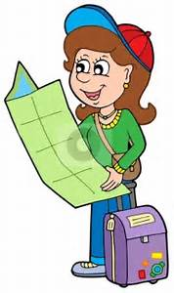
If I look at the map of the United States, I see all our different states.

Slide 5
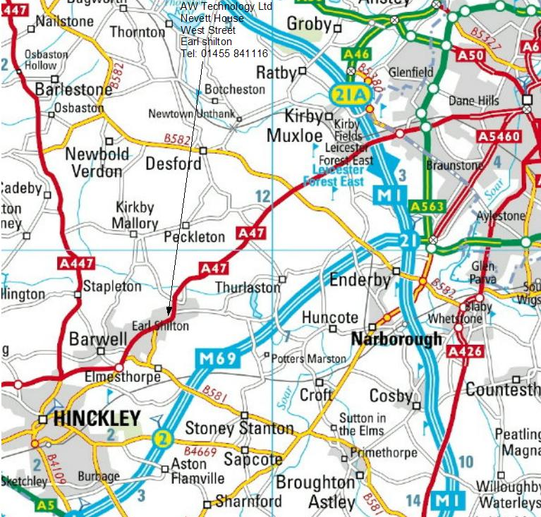
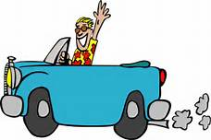
Road maps show streets and highways.
Road maps help people travel or get around in a city or town.

Slide 6
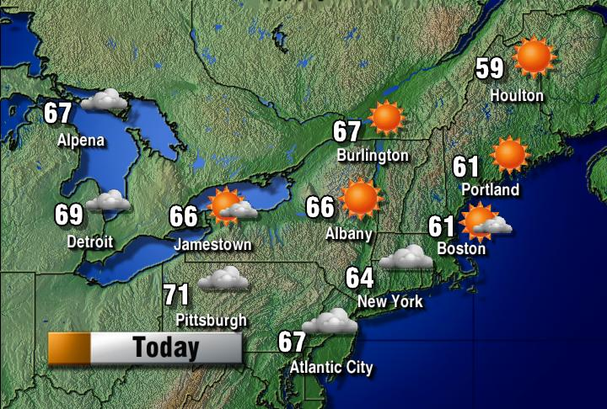
Weather maps show the weather in a place.
Different pictures and colors tell what the temperature or weather is like.

Slide 7


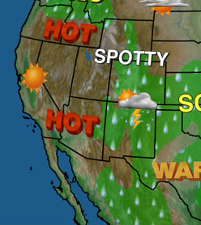
I look at a weather map to see if it will be hot, cold, sunny, or rainy.
Then I know what to wear!

Slide 8
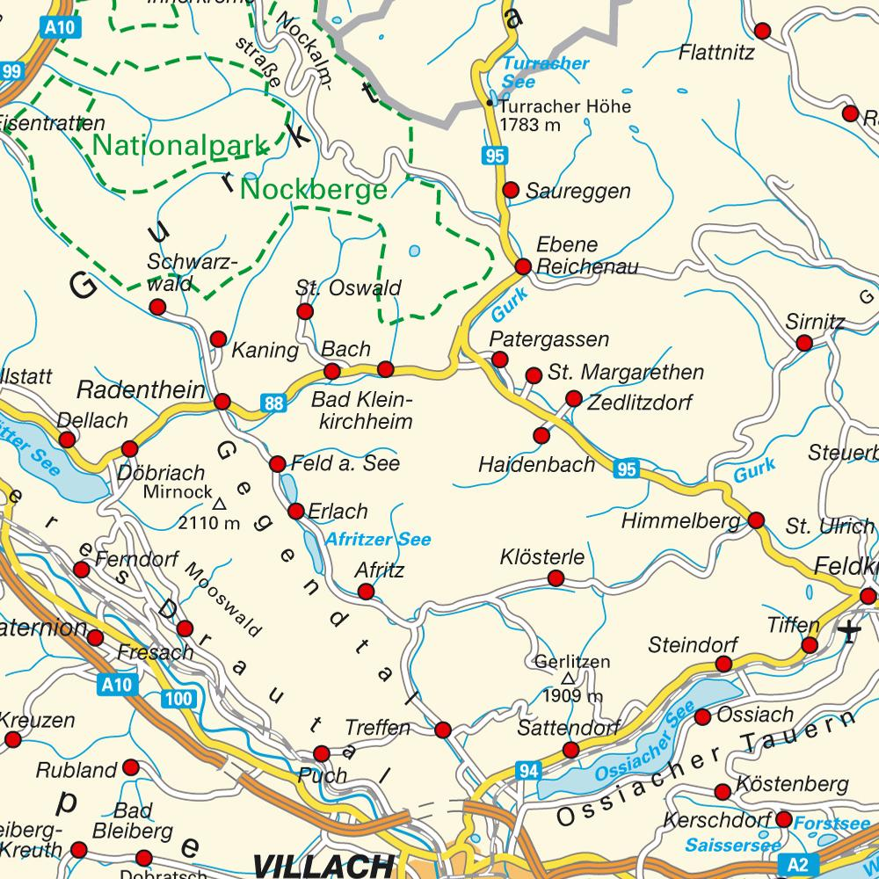
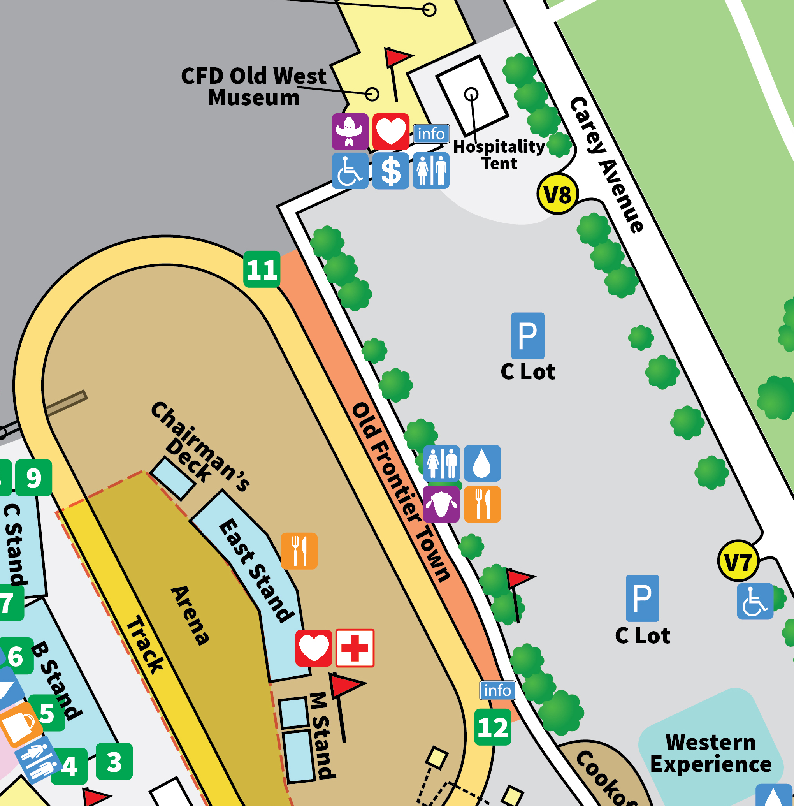
Maps use symbols.
A dot may stand for a city. A ‘P’ may represent the parking lot.

Slide 9
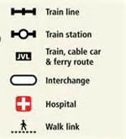
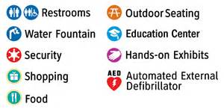
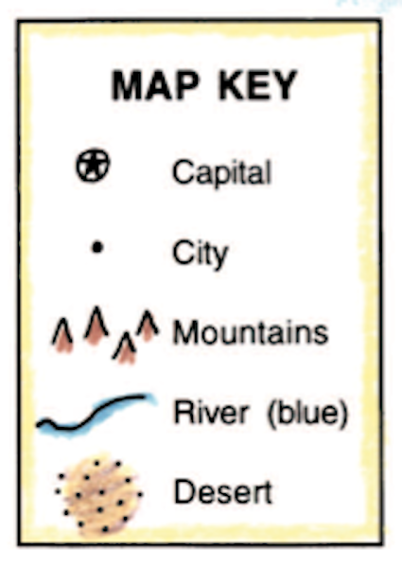
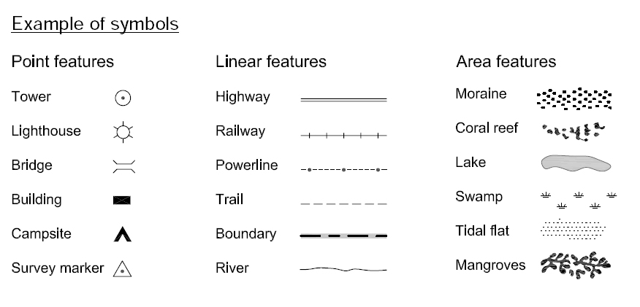
Maps have a key, or legend. This lists each symbol and tells you what they mean.

Slide 10
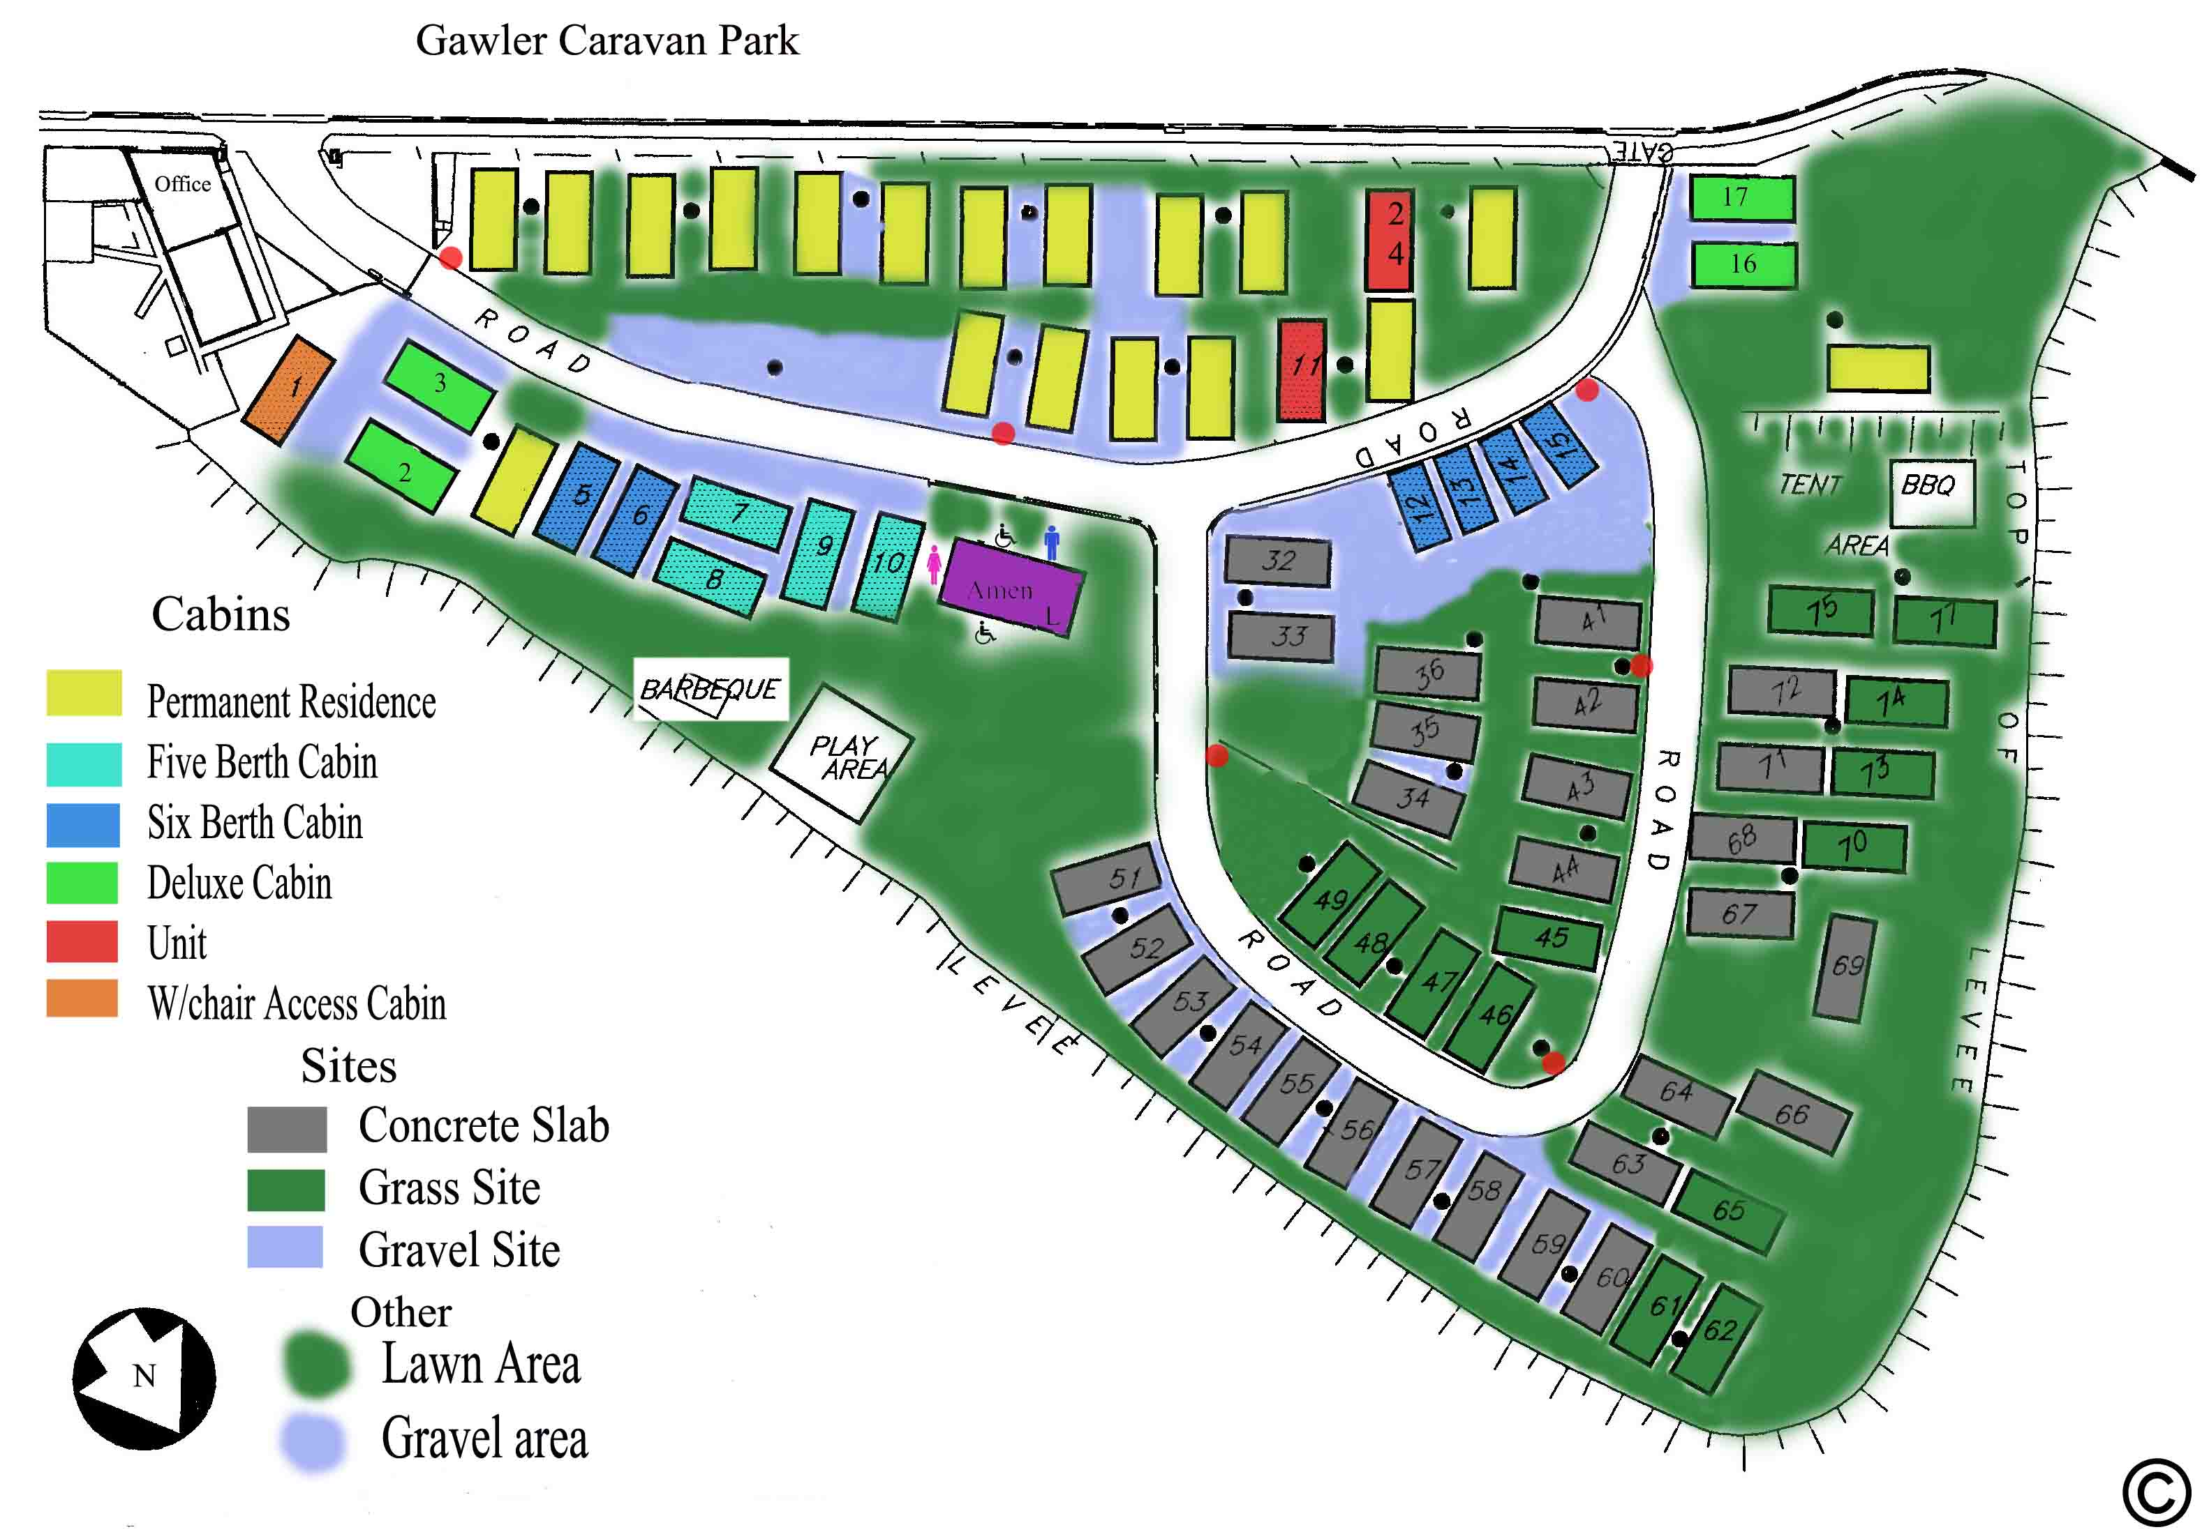

Slide 11
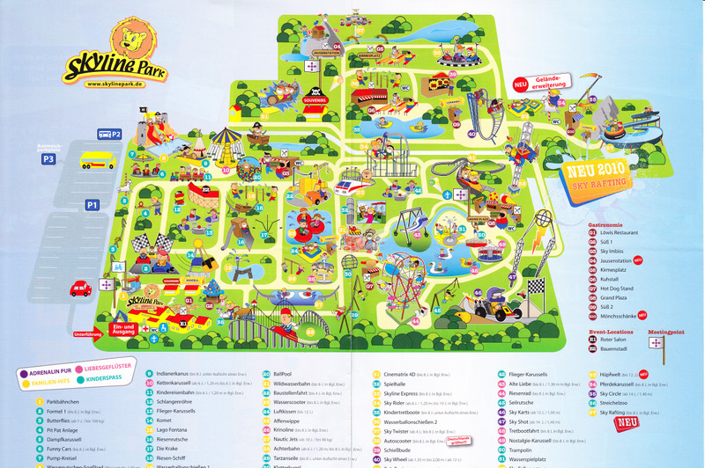

Slide 12
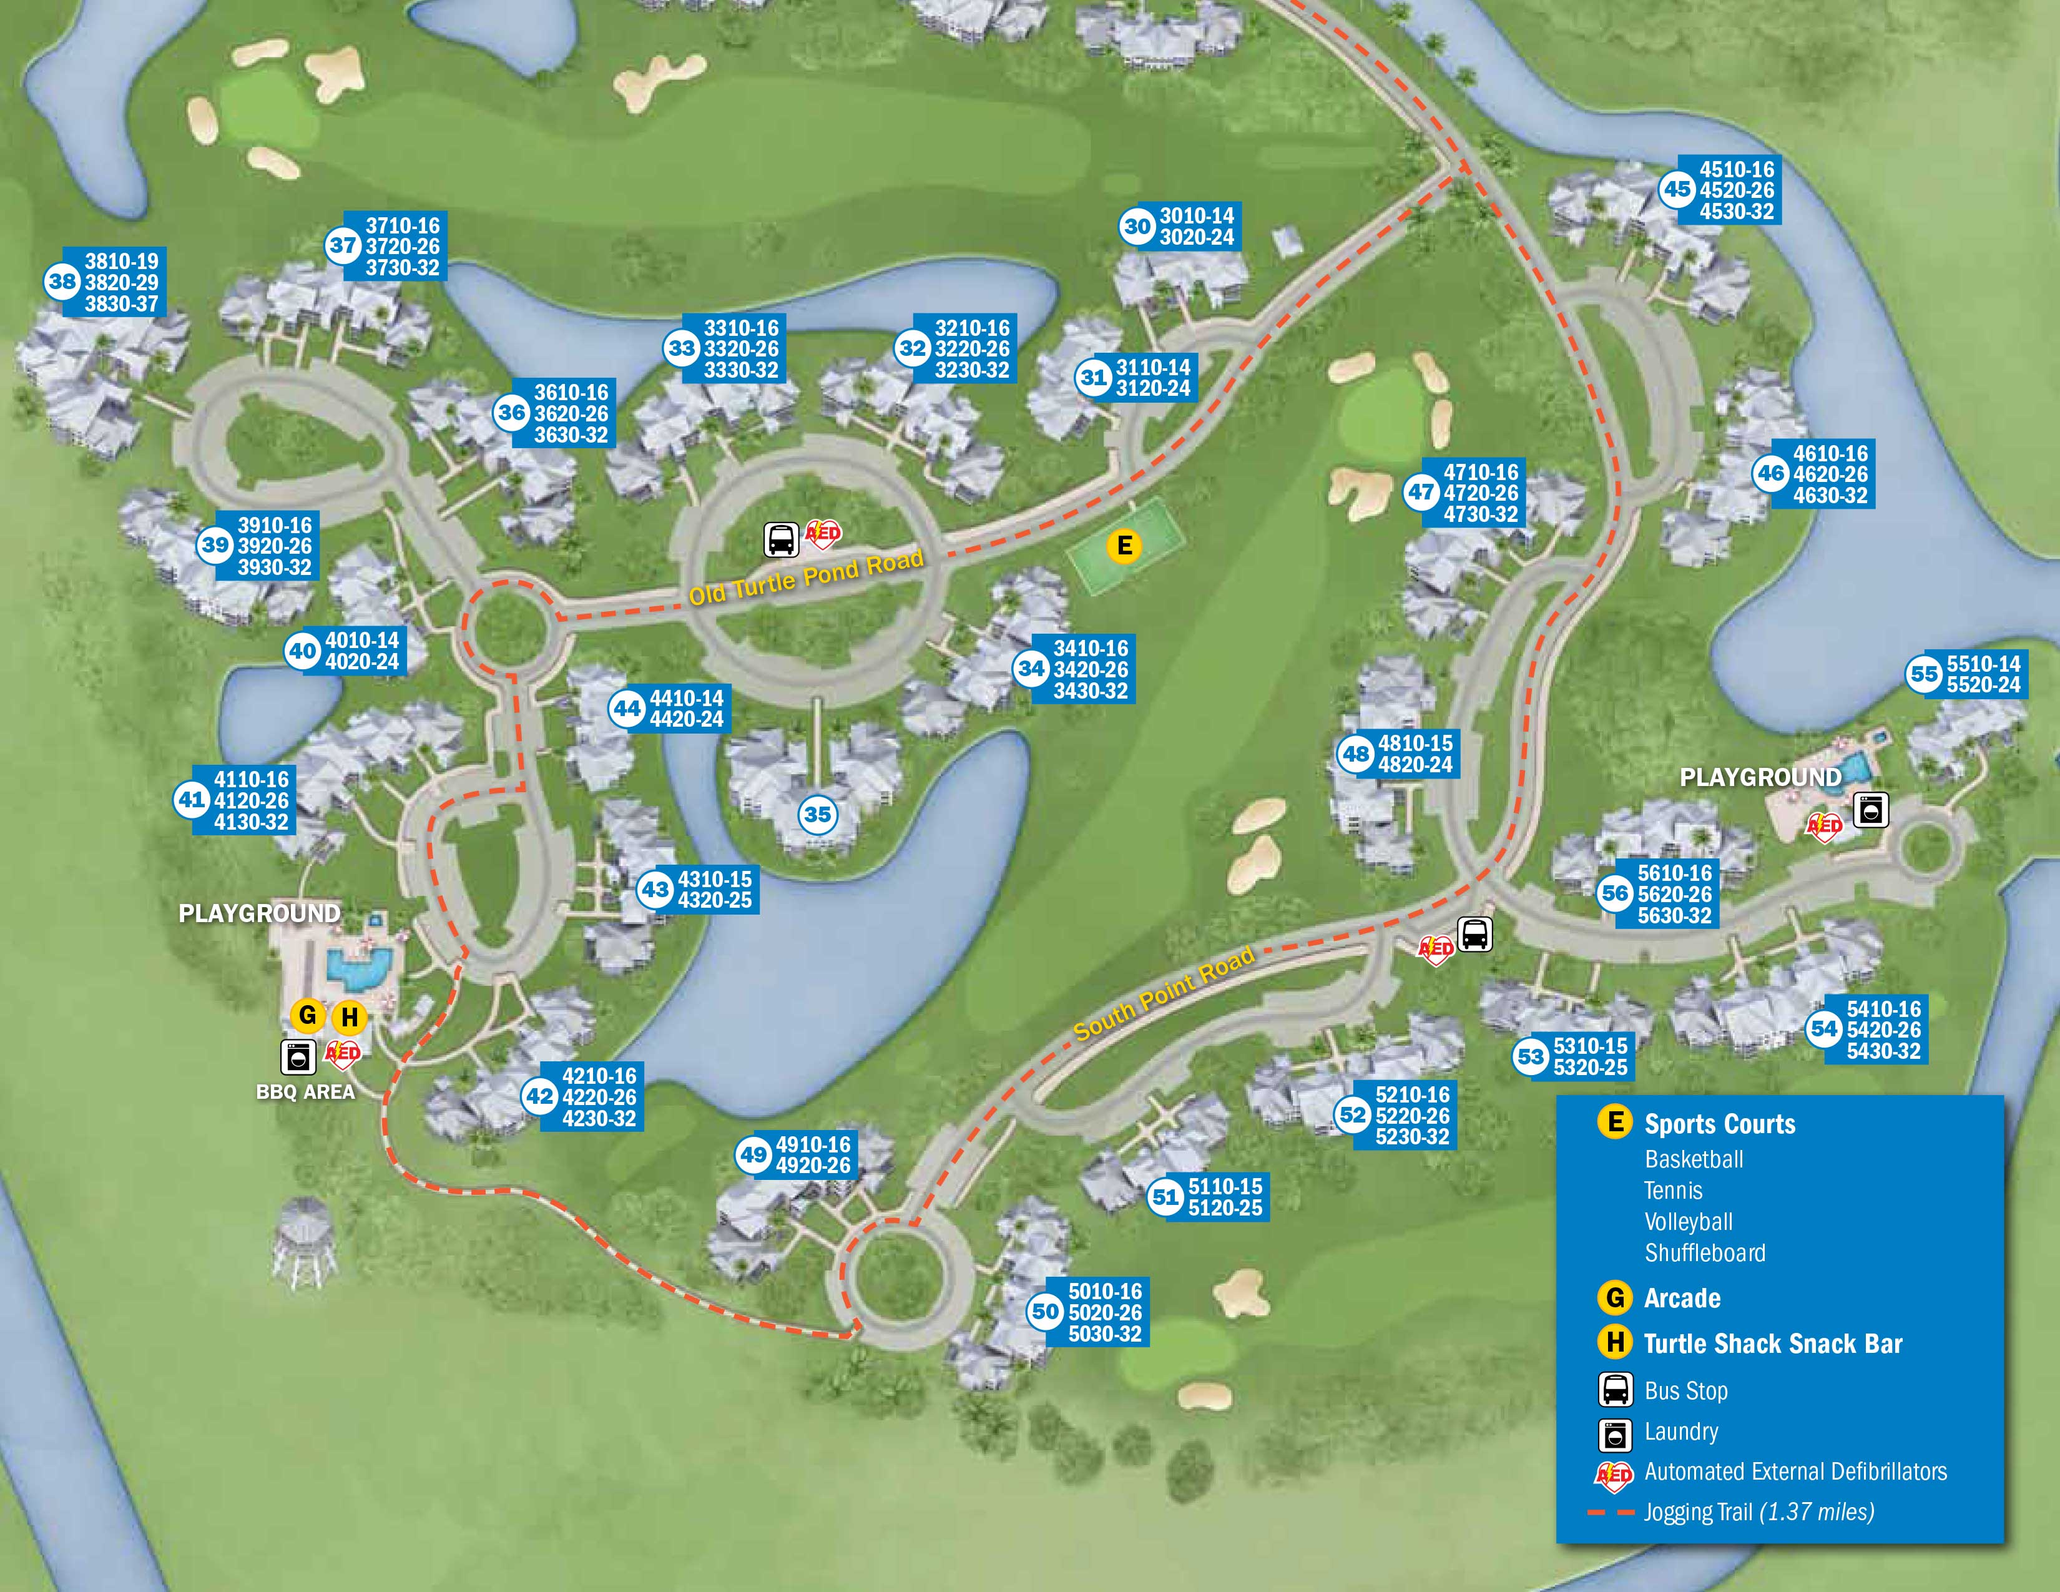
Blue is often used to represent water.
Brown or green is used to show land.

