Slide 1


Elementary Science
Science Focus Lesson
SC.5.E.5.1
Galaxies
Polk County Public Schools
Notes:
Benchmark Clarifications
Students will identify the basic components of a galaxy.
Students will explain how stars can be different.
Students will identify the Sun as a star that emits energy.
Students will identify that the Sun’s appearance is due to its proximity to Earth.
Content Limits
Items will only assess a conceptual understanding of a galaxy. Items will not assess the name of our galaxy in isolation.
Items will not assess objects orbiting stars.
Items that assess stars are limited to brightness, size, or appearance in relation to distance, and that stars emit energy.
Items that address energy emitted by a star are limited to visible light.
Items will not assess the effects of the Sun’s energy on Earth.
Items will not assess numeric values for distance or number of stars.
Items may assess that stars are made of gases but not the specific chemical composition of stars.

Slide 2
SC.5.E.5.1
Benchmark: Recognize that a galaxy consists of gas, dust, and many stars, including any objects orbiting the stars. Identify our home galaxy as the Milky Way.
Essential Question:
What components make up a galaxy and identify our home galaxy?
Vocabulary:
galaxy star
Milky Way planets

Slide 3
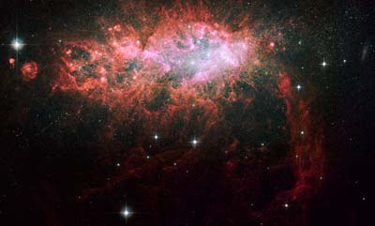
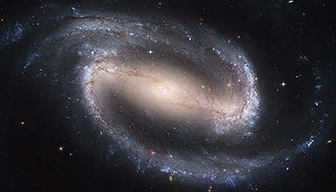
What is a Galaxy?
A galaxy is defined as a large system of stars held together by mutual gravitation and isolated from similar systems by vast regions of space.

Slide 4
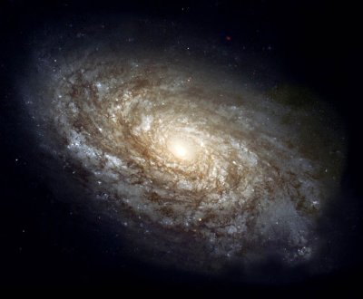
What are the components of a galaxy?
Gas
Dust
Objects that orbit stars
And billions of Stars
Notes:
Object that orbit stars include: planets, moons, asteroids, and comets
The dust and gas can eventually be used in the formation of new stars.

Slide 5
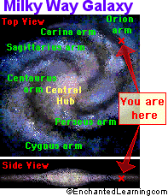
What galaxy do we live in?
We live in the Milky Way Galaxy on an outer arm.
The Milky Way Galaxy has approximately 200 billion stars.
Most of the stars in our galaxy are not visible from Earth.

Slide 6
Summarizing
Pass a paper back and forth between you and your shoulder partner listing what you know about galaxies. Include the components of a galaxy and the name of the galaxy we live in.
Notes:
Give students 30 seconds of think time before they start passing the paper.
Monitor the conversations and lists.

Slide 7
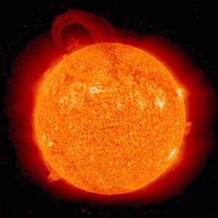
What is a star?
Even the coolest
stars are
HOT! HOT! HOT!
Stars are objects in space that emit energy in the form of visible light.
They are made of mostly hydrogen gas and helium gas.
They come in different colors – blue, white, yellow, red, and red-orange.
Our star is the Sun and it is the ONLY star in our solar system. It provides energy to the planets in the form of visible light.
Blue Star
Hottest
White Star
Yellow Star
Red Star
Coolest
Red-Orange Star

Slide 8
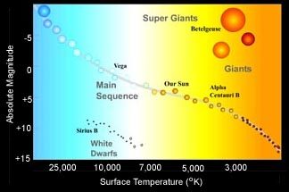
How bright is that star?
Our sun is an average star.
Some stars are brighter than others. A star’s brightness is described by its actual brightness and how bright it appears to people on Earth.
If two stars have the same brightness but one is farther away, the one that is closer will look brighter.
The sun appears to be the brightest and largest star in our sky because it is the closest. In reality it other stars are much brighter and larger but they are very far from Earth so they appear small and dim compared to the sun.
Notes:
The sun is an average star.
It falls in the middle when it comes to brightness, temperature and size.
It is a yellow star.

Slide 9


Why does our Sun look so big?
Observe the same basketball up close and then REALLY far away.
The Sun looks big to us because it is the closest star to Earth.
Notes:
Do the following insta-lab with the students. Show the slide and/or get a basketball and DO IT. This slide will need a click to view “Observe the same basketball up close and then really far away” pause DON’T CLICK until you have had the students observe and/or do the activity. When you reveal the answer…”The sun looks big to us because it is the closest star to Earth” This will be a WOW moment for your students.

Slide 10
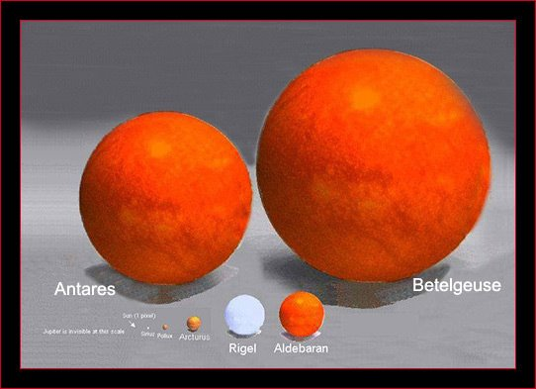
How does the Sun compare to other stars?
The Sun is a medium size star; it appears much larger than all of the other stars because it is so close to us and the other stars are very far away.

Slide 11
Summarizing
In your science journal answer the question below with your partner.
How can an object appear smaller than another object if it is really much larger than that object?
Ex. The star Betelgeuse is much larger than our Sun but theSun appears larger.

Slide 12
Guided Instruction:
A star named Sirius appears as the brightest star in the night time sky, even though a star named Pollux actually gives off more light. Which of the following best explains why Sirius appears brighter than Pollux in our nighttime sky?
Sirius has a different color than Pollux does.
Sirius has different gases than Pollux does.
Sirius is closer to Earth than Pollux is.
Sirius is larger than Pollux is.

Slide 13
C
The answer is
Sirius is closer to Earth than Pollux. When a star is closer to the earth it can appear larger than other stars that may be bigger.

Slide 14
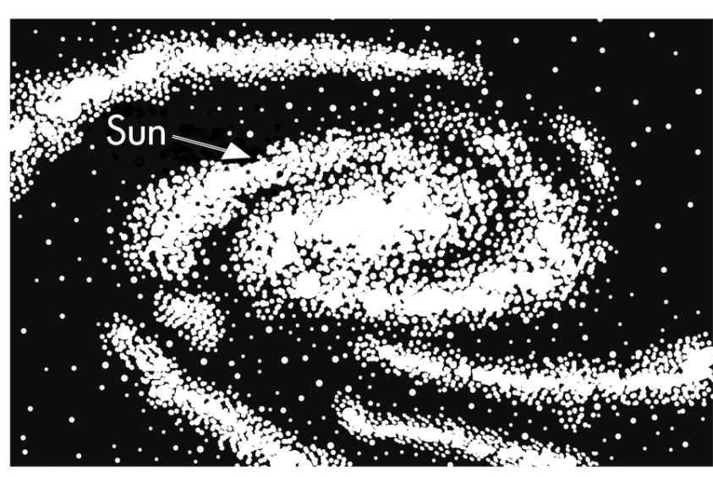
Guided Instruction:
There are so many stars in the universe that it is hard to count them.
Our Sun is a star that is located near the edge of the large group of stars shown here.
What is this large group of stars called?
the Milky Way galaxy
the universe
the Whirlpool galaxy
the solar system

Slide 15
A
The answer is
The sun is in the Milky Way Galaxy which includes many other stars.
The only star in our solar system is the Sun and there are multiple galaxies in the universe.

Slide 16
Guided Instruction
The Sun, like other stars, is a ball of hot, glowing gas. Which statement best describes the Sun?
The Sun is one of billions of stars in the universe.
The Sun is one of billions of stars in the solar system.
The Sun is at the center of the Milky Way galaxy.
The Sun is farther from Earth than any other star.

Slide 17
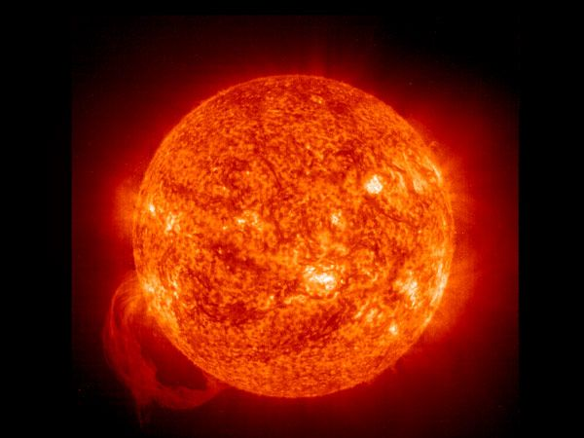
A
The answer is
The Sun is one of billions of stars in the universe.
Notes:
The sun is the only star in our solar system.
The sun is on an outer ring of the Milky Way.
The sun is the closest star to Earth.

Slide 18
Guided Instruction:
Constellations, or patterns of light in the sky, are made up of which of the following?
stars
glowing planets
comets
meteors

Slide 19
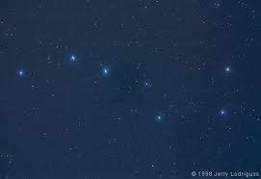
A
The answer is
Stars
Notes:
Stars are the only thing in the galaxy that emits energy in the form of visible light all others reflect a star’s light

Slide 20
Summarizing
Essential Question:
Partner A tell B what is in a galaxy.
Partner B tell A what the sun is made of and why it looks so large.

Slide 21
Check Your Understanding
1. What items make up a galaxy?
Gas & Dust
Objects that orbit stars
Many Stars
All of the above

Slide 22
Check Your Understanding
2. There are so many stars and planets in the universe that it is hard to count them.
Our Solar system is located near the edge of the large group of stars shown here.
What is this large group of stars called?
the solar system
the Milky Way galaxy
the universe
the Whirlpool galaxy

Slide 23
Check Your Understanding
3. Why does the Sun seem larger and brighter than other stars?
The Sun can be seen from Earth during daylight hours.
The Sun reflects light from all the moons in the solar system.
The Sun is closer to Earth than other stars in the universe.
The Sun can make its own light.

Slide 24
Check Your Understanding
4. Which statement best describes our Sun?
It is one of many stars in the universe.
It is the only star in the universe.
It is a planet in our solar system.
It is a type of comet.

Slide 25
Check Your Answers
D. All of the above – Gas, Dust, object that orbit stars, and many stars
B. the Milky Way galaxy
C. The Sun is closer to Earth than other stars in the universe.
A. It is one of many stars in the universe.
Notes:
Galaxies are made of gas, dust objects that orbit stars and many stars
Our solar system is in the Milky Way galaxy
The Sun seems larger and brighter because it is closer to Earth than other stars in the universe
The statement that best describes the Sun is that it is one of many stars in the universe.

Slide 26
Summary Question
What components make up a galaxy? In what galaxy is our solar system located?

