Slide 1
Review of online Class 2
Vocabulary, tone, class overview of assignments expected

Slide 2
Class Overview
Review essay format for thought questions
Usage of “No Struggle” essay format to answer achieve article Thought questions
Calendar posts will keep you on task. Print it and keep with ELA notes for daily references
Dailey reading of 30 minutes and submission of reading log by Thursday for teacher review.
Monday and Wednesday Achieve articles : 1 Activity only and 1 assigned with Thought Question answered in essay format.
Tuesday and Thursday Istation log in and complete assignment for minimum 45 minutes each day.
Any questions? Always reach out to me any day and any time. I will get back to you!

Slide 3
Words create the tone and theme
*complete questions below
What tone was set with the choice of words in pages 1-4?
What are three ways that Jonas’s world is different from our own?
What is your favorite part of this section?
Jonas remembers a time when he exclaimed to his friend during a game, “That’s it, Asher! You’re released!” and received a stern talking to for using the term ‘released’ so lightly. What does it mean to be “released” in Jonas’s world? Why is it such a serious matter?
******PLEASE ANSWER EACH OF THE QUESTIONS IN WELL THOUGHT OUT ANSWERS, COMPLETE SENTENCES AND CITE EVIDENCE TO BACK UP FINDINGS . SUBMIT THROUGH THE BPA WEBSITE UNDER THIS ASSIGNMENT. Do not forget to reinstate the questions so I am aware of what you are answering.

Slide 4
“The Giver” (vocabulary) Please insert the vocab in the correct sentences below. Rewrite sentences below in homework submission chat box on BPA website
*palpable*transgression*adherence*chastise*petulantly*conviction
1. After being told he couldn’t go out, Jacob started ____________ shouting at his parents.
2. As Emma stood to make her speech, her nervousness was almost _____________.
3. My strongest ______________ is that people should put the environment first.
4. _______________ to traffic laws keeps everyone safe on the road.
5. The teacher is going to __________ the students for passing notes in class.
6. I forgot to wear my seatbelt this morning. It was a __________ which earned me a ticket when the police pulled my car over.

Slide 5
Overview of Every week’s work
Monday Online Zoom class attendance prepared from previous weeks INDEPENDENT reading. -evening homework complete any worksheets unfinished from class discussion
Tuesday log into Istation 45 minutes ELA contact Mrs. A for sign in information
Wednesday complete Achieve 3000 article assigned with complete “Thought Question” in “No Struggle” essay format
Thursday/Friday
log into Istation 45 minutes ELA contact Mrs. A for sign in information
Read chapters assigned on BPA website, Complete work sheets assigned on BPA website Please submit a brief summary no more than 500 words using a least 3-5 vocab terms we have been discussing in class. Submit summary in the chat box after reading each chapter or as you read along to keep track. Be prepared to discuss in class Monday.

Slide 6
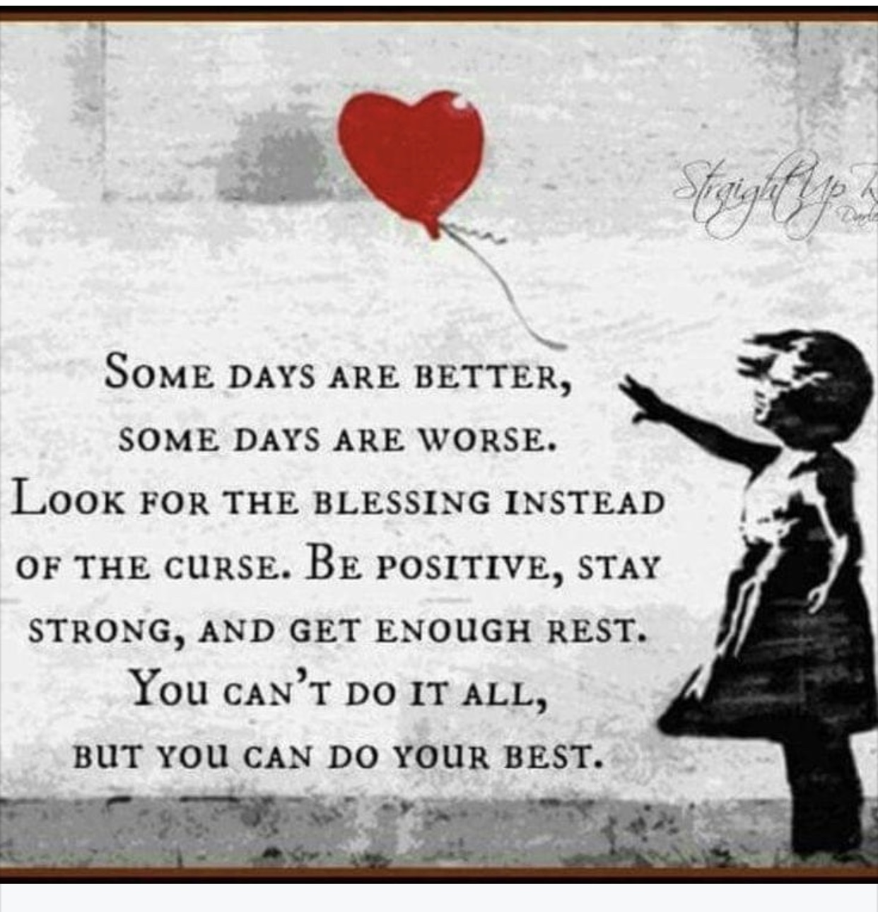
Rea

