Slide 1
Math Equal Parts

Slide 2
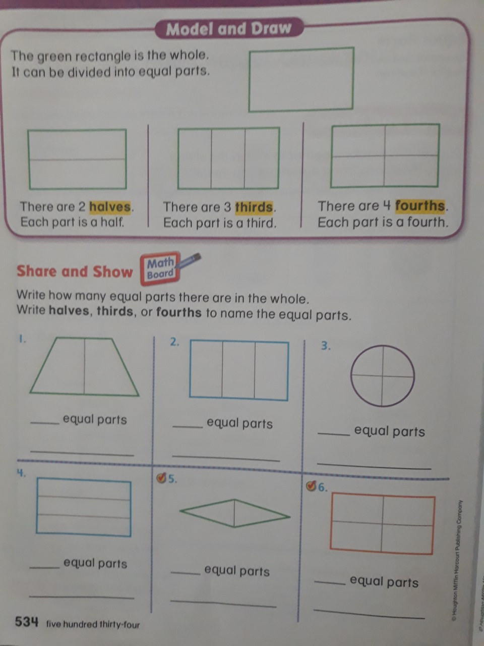

Slide 3
