Slide 1
Math 2D shapes
Mrs. Alonso

Slide 2
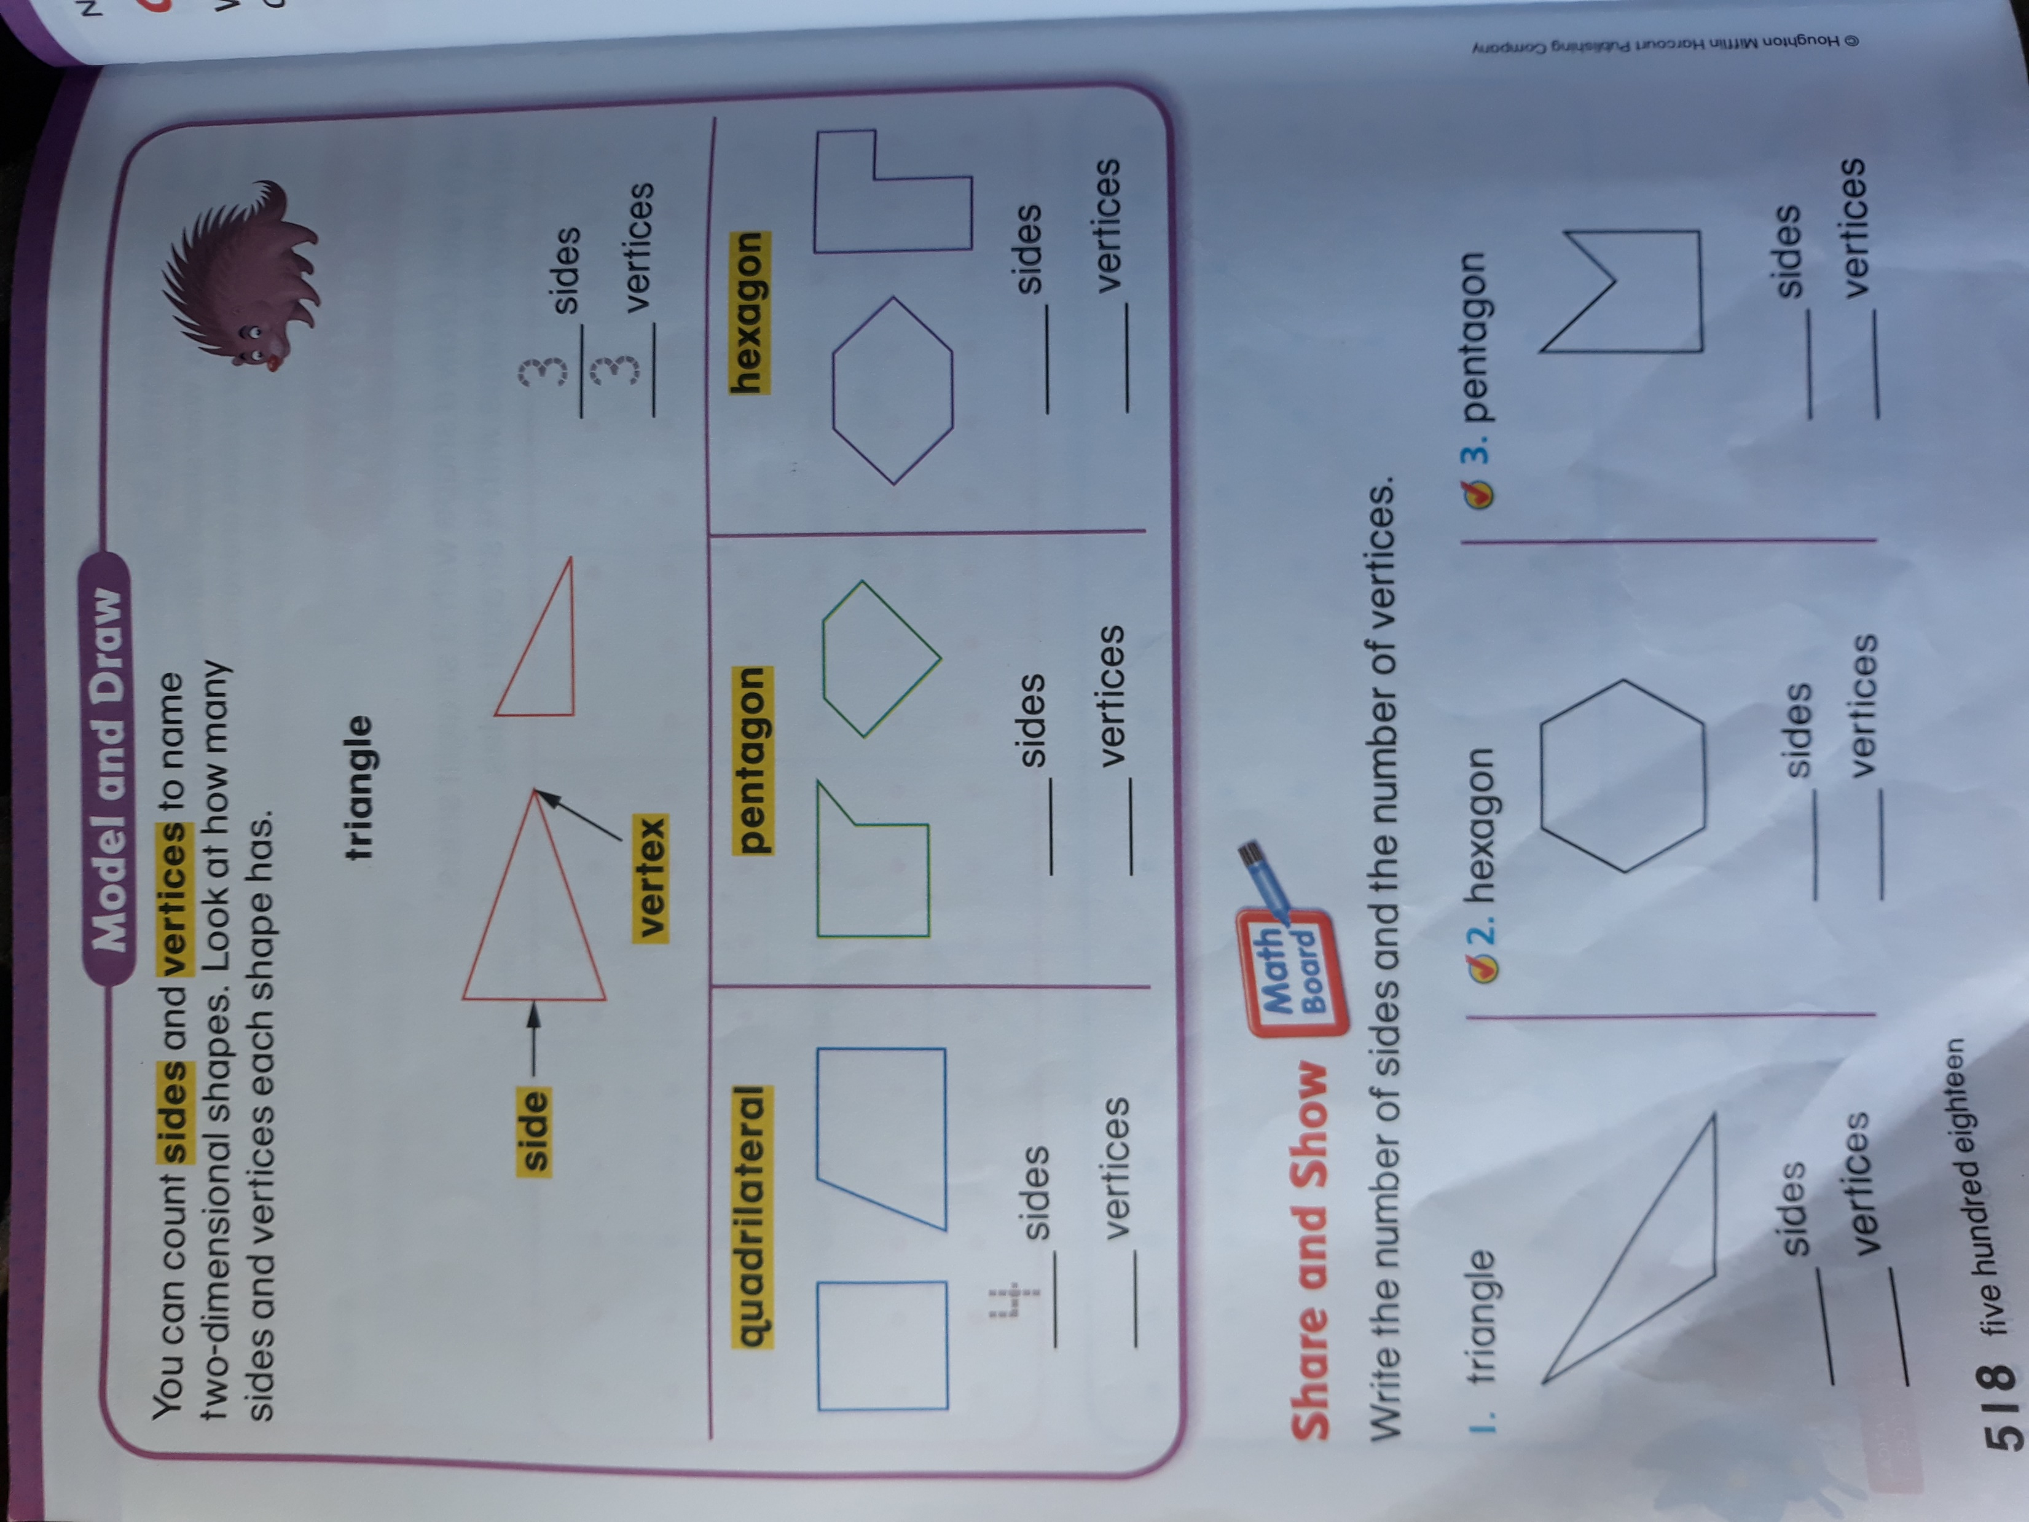

Slide 3
