Slide 1

What do you know about the Sun?
Introduction
Notes:
Ask the question and give students time to think about an answer. You might have them talk to a neighbor to generate ideas. After sufficient wait time move to the next slide. Ask students to share their ideas about the sun.

Slide 2
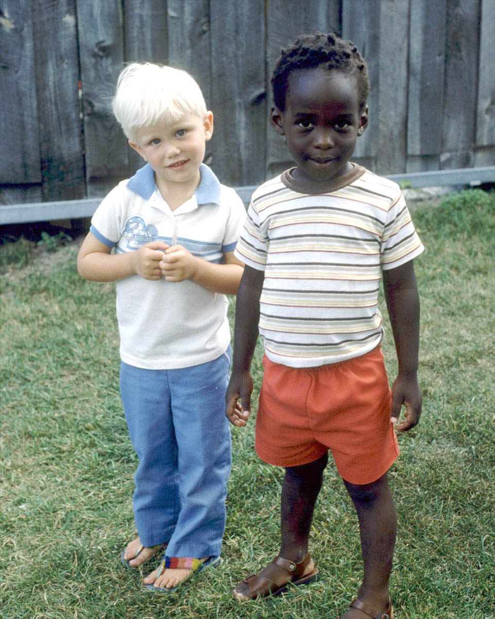

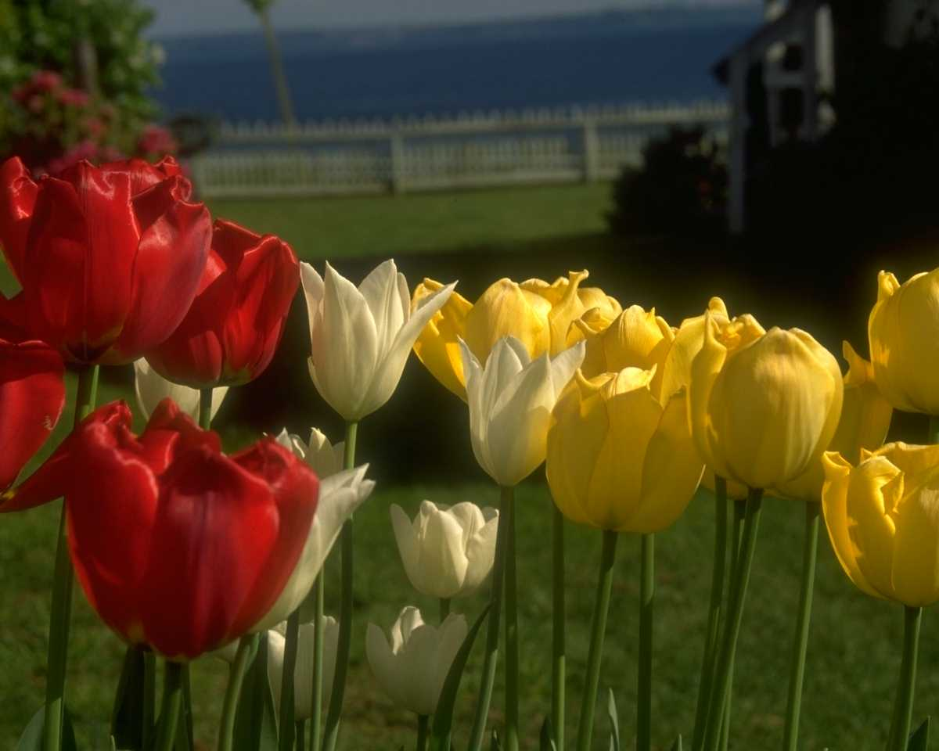
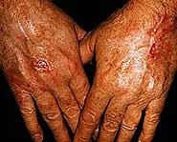
The Sun
Good
Bad
Keeps Us Warm
Causes Sunburns
Helps Plants Grow
Makes Our Skin Wrinkle
Introduction
Notes:
Give students ample time to generate ideas.
Listen to all student responses and then let the students know that you have pictures of a few things that show what we know about what our sun can do. Continue to mouse click until all four examples are on the screen. Ask students to look at the four pictures that you have selected and to put them into two categories. After students have shared their ideas for categories, mouse click again to show the text “Good” and “Bad” on the slide and ask students why you have selected these categories. Fill in any background information for students to help them understand why sunburns and wrinkles are not good for our skin (for background information go to the SunWise Web site: www.epa.gov/sunwise/uvandhealth2.html) .
Use the next two slides to expand on the list in each category. Have students participate by filling in the blanks to finish the words.
Hopefully some of the responses were already generated by the students.

Slide 3
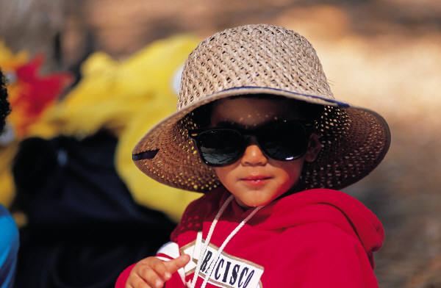
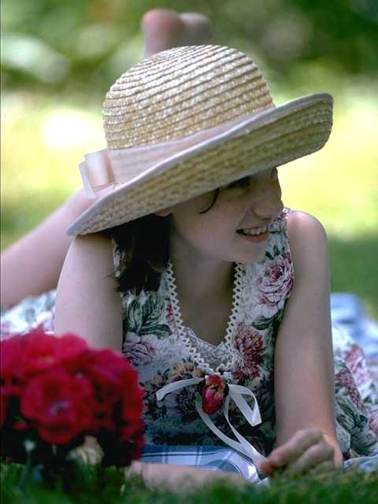
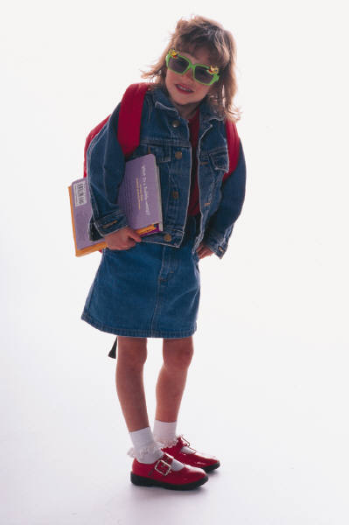

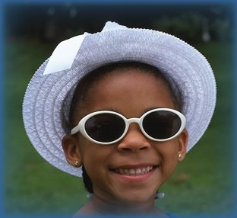
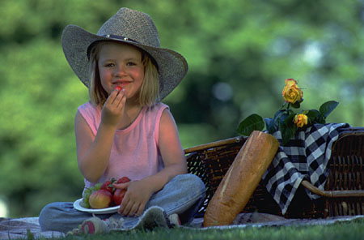
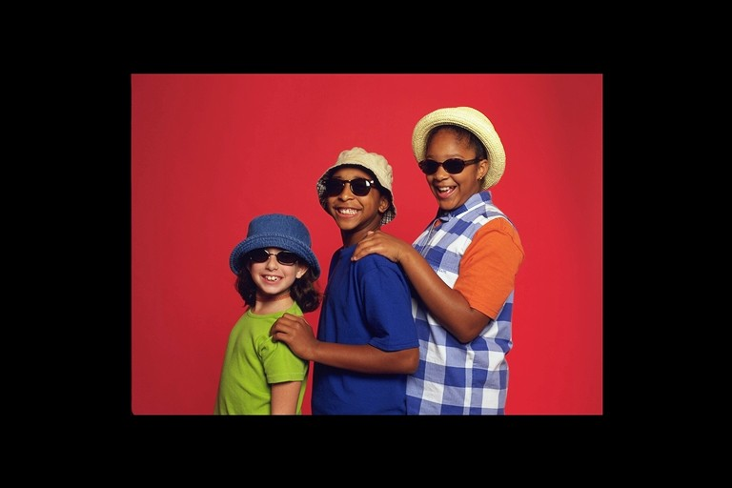
Be SunWise
Notes:
Ask students to look at the pictures and come up with a definition for the word “SunWise.” You may chart the responses and keep them posted for later reference. Tell students that they are going to receive more information about SunWise and that you will revisit the definitions later.

Slide 4
The Sun
Good
Bad
Keeps Us Warm
Helps Plants Grow
Makes Vitamin D
Makes Vitamin _
Kills Ge_m_
Kills Germs
Makes Us Feel Good
Makes Us F__l Good
Gives Us Light
Introduction
G_v_s Us Light

Slide 5
The Sun
Good
Bad
Causes Sunburns
Makes Our Skin Wrinkle
Causes S_i_ Cancer
Causes Skin Cancer
Causes E_e Damage
Causes Eye Damage
Introduction

Slide 6
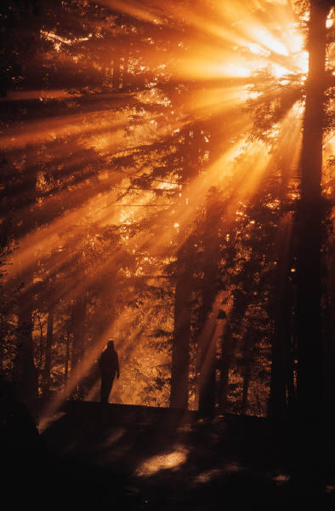
The Sun…
…is necessary for life on Earth.
It helps plants to grow, and provides warmth and light.
Sunlight also helps people to be happy and healthy.
Introduction
Notes:
Summarize information about the sun…
For additional information go to the SunWise Web site (www.epa.gov/sunwise) or the SunWise kid pages (www.epa.gov/sunwise/kids.html)

Slide 7
The Sun…
…produces light and warmth but also ultraviolet (UV) radiation. UV radiation cannot be seen or felt.
It is UV radiation, not the warmth or brightness of the sun that causes changes to skin color, damage to eyes, and other bad health effects.
Introduction
Notes:
Point out that the sun also produces ultraviolet (UV) radiation that can be potentially harmful to us. Stress (as much as possible for this age group) that it is UV radiation, not the light or warmth that causes the harmful effects.

Slide 8


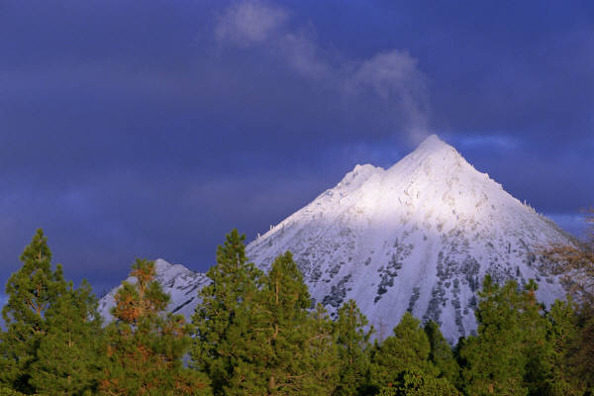
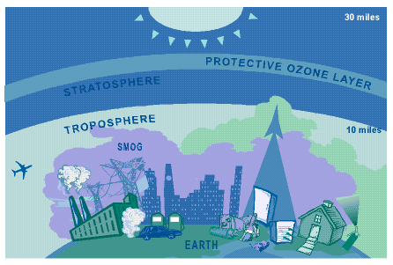
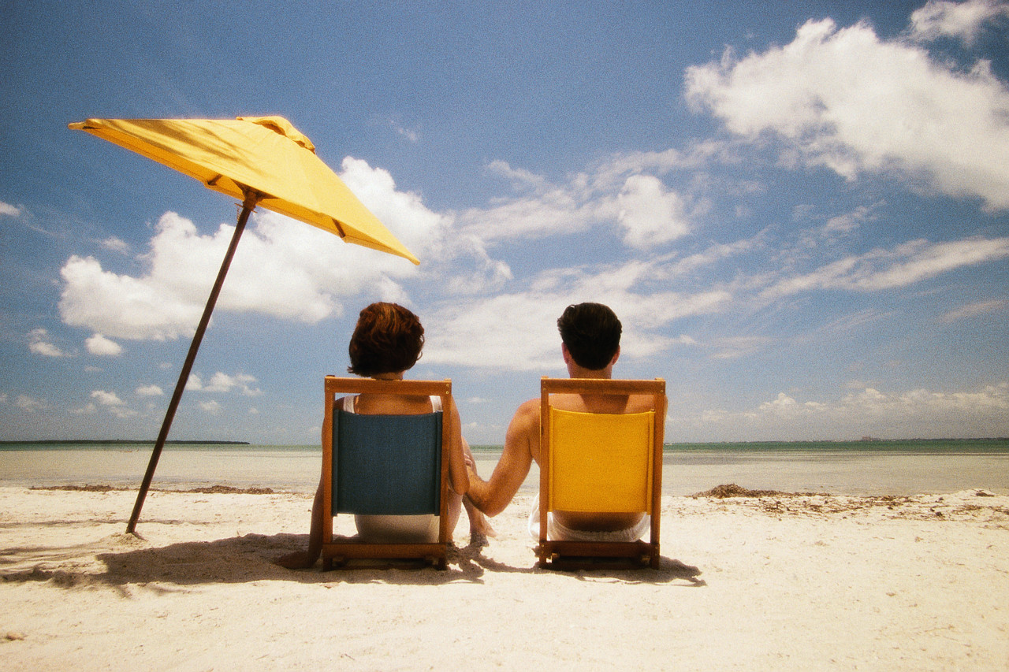
UV radiation is not always the same – it changes based on…
Time of day
Time of year
Location
Altitude
Weather
Reflection
Ozone Layer
Introduction
Notes:
(General UV information: www.epa.gov/sunwise/uvindex.html)
Give students example of each variable that fits with their experiences such as:
Time of day: early morning vs. late at night (Note: Remember the shadow rule: Watch Your Shadow. No Shadow, Seek Shade!)
Time of year: summer vs. winter
Location: black top vs. under the shade of a tree
Altitude: in the mountains
Weather: cloudy vs. clear
Reflections: snow and water
Ozone layer: is thinning and offering less protection against harmful UV rays
(Until recently, chlorofluorocarbons (CFCs) were used widely in industry and elsewhere as refrigerants, insulating foams, and solvents. When CFCs break down in the stratosphere, they release chlorine, which attacks ozone. www.epa.gov/sunwise/ozonelayer.html)
Information on the UV Index and why it varies: www.cpc.ncep.noaa.gov/products/stratosphere/uv_index/uv_information.html

Slide 9
How do we measure UV radiation levels?
11+
We use the UV Index Scale.
Reported on a scale of 1 -11+.
10
9
8
7
6
Take special care when the UV Index is 5-6 or higher.
5
4
3
2
1
UV
Introduction
index
Notes:
The UV Index is a prediction (based on a mathematical equation available at www.epa.gov/sunwise/uvcalc.html) of the UV level at noon. It can be used as a tool (much like a thermometer is a tool for temperature) for reminding people how to protect themselves from overexposure to UV radiation. The higher the UV Index level, the greater the possibility of damage to the skin and eyes in less time. Ask students to think back to the pictures of people being SunWise that you used when asking them to form a definition. What were some of the ways that people were taking special care to protect themselves from the UV radiation levels? Students should remember the use of sunglasses, wide-brimmed hats and clothing.

Slide 10
How Can You Become SunWise?
Notes:
Again ask students to think about the definition of SunWise that they formed at the start of the lesson. Tell them that you will now go over some specific ways to become SunWise.
www.epa.gov/sunwise/actionsteps.html

Slide 11









Sun Safety Action Steps
Limit Time in the Midday Sun
Wear Sunglasses
Seek Shade
Use Sunscreen
Cover Up
Avoid Tanning Parlors
Watch for the UV Index
Wear a Hat
Health Effects
SunWise
Notes:
As you read and review each Action Step with the students ask them to think of the action steps that are part of their routine.

Slide 12


Sun Safety Action Steps
Limit Time in the Midday Sun
The sun’s rays are strongest between 10 a.m. and 4 p.m.
Limit exposure to the sun during these hours.
Introduction

Slide 13
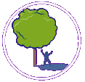
Sun Safety Action Steps
Seek Shade
Staying under cover is one of the best ways to protect yourself from the sun.
But remember, shade structures do not offer complete sun protection.
Introduction

Slide 14

Sun Safety Action Steps
Cover Up
Wearing long sleeves and long pants is a good way to protect your skin from the sun’s UV rays.
Introduction

Slide 15
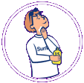
Sun Safety Action Steps
Use
Sunscreen
Use sunscreen of SPF 15+ generously and reapply every 2 hours, or after working, swimming, playing, or exercising outdoors.
Introduction

Slide 16

Sun Safety Action Steps
Wear a Hat
A hat with a wide brim offers good sun protection for your eyes, ears, face, and the back of your neck.
Introduction

Slide 17
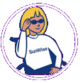
Sun Safety Action Steps
Wear
Sunglasses
Sunglasses that provide 99 to 100 percent UV protection will greatly reduce sun exposure that can lead to eye damage.
Introduction

Slide 18

Sun Safety Action Steps
Avoid Tanning Parlors
The light source from sunbeds and sunlamps damages the skin and unprotected eyes. It is a good idea to avoid artificial sources of UV light.
Introduction

Slide 19
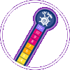
Sun Safety Action Steps
Watch for
the UV Index
The UV Index provides important information to help you plan your outdoor activities in ways that prevent overexposure to the sun. The UV Index is issued daily across the United States.
Introduction

