Slide 1


Elementary Science
Science Focus Lesson
SC.5.P.10.1
Forms of Energy
Polk County Public Schools
Notes:
Benchmark Clarifications
Students will identify and/or describe some basic forms of energy. Students will describe that light travels in a straight line until it strikes an object or travels from one material to another. Students will explain that heat is produced when two objects are rubbed against each other. Students will explain that sound is produced by vibrations and/or that pitch depends on how fast or slow the object vibrates.
Content Limits
Items assessing basic forms of energy are limited to light, heat(thermal), sound, electrical, chemical, and mechanical energy. Items will NOT assess transfer of energy. Items assessing light reflection, refraction, or absorption should use the terms reflect, bend, or absorb to describe light’s behavior.
Stimulus Attribute
The terms material or substance should be used rather than the terms medium or media. Scenarios referring to mechanical energy should not use the terms kinetic energy or potential energy.

Slide 2
SC.5.P.10.1
Benchmark: Investigate and describe some basic forms of energy, including light, heat, sound electrical, chemical, and mechanical.
Essential Question:
What are some basic forms of energy?
Vocabulary:
energy light energy heat(thermal) energy
sound energy electrical energy chemical energy
mechanical energy

Slide 3



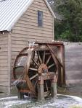
Energy
Energy – the ability to cause changes in matter
A moving car has energy. The race car’s engine changes the
energy stored in gasoline into movement. The car moves because
one form of energy changes into another.
A boy riding a bike has energy. The boys muscles supply the
energy to pedal the bike. Moving the pedals makes the bike
move.
A baseball player has energy. He must get energy inside his
body from the food he eats to be able to hit the ball.
A water wheel has energy. The moving water supplies the energy to turn the water wheel.

Slide 4
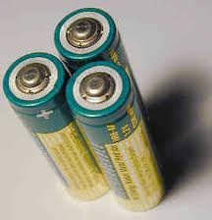
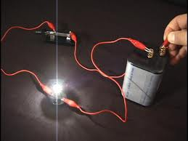
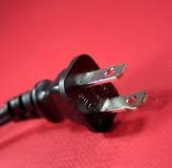
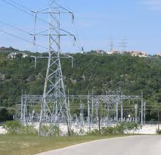
Energy comes in many forms.
Basic Forms of Energy
Electrical Energy
is the energy produced when electrons move from one place to another place. The movement of electrons is electricity.
Electrical charges can turn on lights, cool your home, and allow your TV to turn on.
Notes:
Items assessing basic forms of energy are limited to light, heat (thermal), sound, electrical, chemical, and mechanical energy.
Items will NOT assess the transfer of energy.

Slide 5
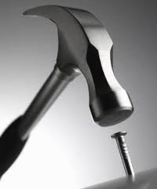
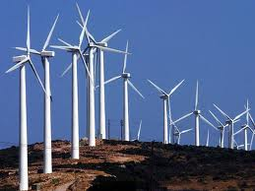
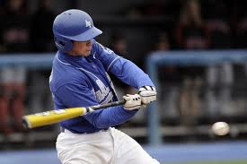
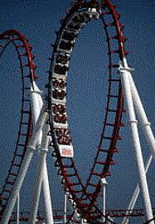
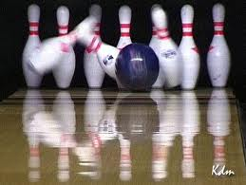
Basic Forms of Energy
Mechanical Energy
is the energy an object has because
due to its motion or due to its position.
When work is done on an object, that object gains energy. The energy acquired by the object on which work is done is known as mechanical energy.
Notes:
Scenarios referring to mechanical energy should NOT use the terms kinetic energy or potential energy.

Slide 6
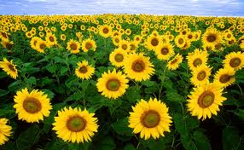
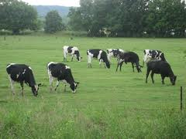
Basic Forms of Energy
Chemical Energy
is the energy stored in materials such as food and fuels. Chemical energy is the result of atoms and molecules interacting.
Plants use the energy in sunlight to make food. In the process, the sun’s light energy is changed to chemical energy. Some of the chemical energy is stored in the plant. Animals that eat the plants take in this chemical energy and animals that eat plant-eating animals also take in the chemical energy. You and other animals use this energy to stay alive.

Slide 7

Summarize
Partner A: Tell your shoulder partner what ENERGY is.
Partner B: Tell your shoulder partner the 3 different forms of energy you reviewed and give examples of each.
Notes:
Energy is the ability to cause change
Electrical energy, mechanical energy, and chemical energy

Slide 8
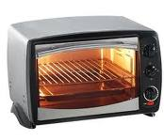
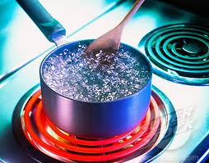
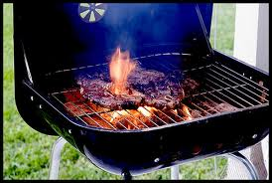
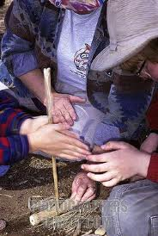
Basic Forms of Energy
Heat Energy (also called thermal energy)
is the energy of moving particles. Moving particles have energy.
Particles in the pot move faster then the
particles in water move faster. The more
the water particles are heated, the faster
they move.
Heat energy can be produced in
different ways. All of these ways change another form of energy into heat energy.
The energy of motion can produce heat energy. Heat is produced
when two objects are rubbed against each other.
Notes:
Items will NOT assess the transfer of energy.

Slide 9
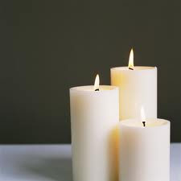
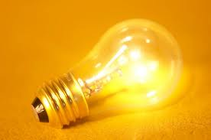
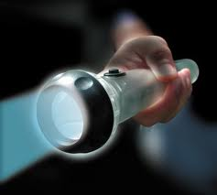

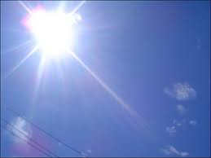
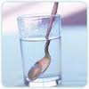
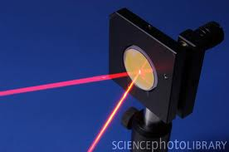
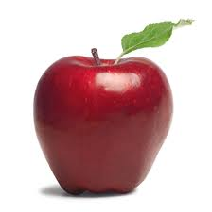
Basic Forms of Energy
Light Energy is the energy that travels in waves.
Light travels in a straight line until it strikes and object or travels from one material to another.
When light passes from one object to another, light changes
direction slightly. This is called refraction.
If you shine light on a surface, some of that light will bounce off, or be reflected by, the surface. This process is called reflection.
Light can be taken in by an object. This means it is absorbed. Most objects absorb some colors of light. Only clear objects transmit the light that hits them.
Notes:
Items assessing light reflection, refraction, or absorption should use the terms reflect, bend, or absorb to describe light’s behavior.

Slide 10
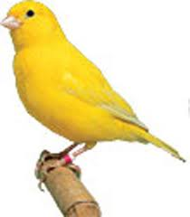
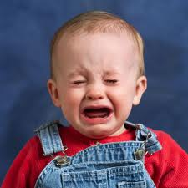

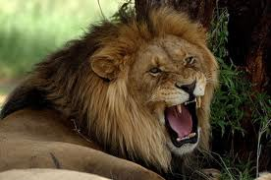
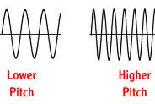
Basic Forms of Energy
Sound Energy
is the energy carried by sound waves which
are produced when an object vibrates.
The different vibrations that cause these sounds are carried by sound
waves with different characteristics.
The pitch of a sound is how high or low the sound is. When vibrations are short
the pitch is high. When vibrations are long, the pitch is low.

Slide 11

Summary
With your shoulder partner, have a discussion about the following:
Discuss these three words associated with
light: reflect, refract, absorb
Discuss the difference between low pitch and
high pitch
Identify and give examples of the all the forms of energy we
reviewed this week

Slide 12
Guided Practice Work with your shoulder partner to answer each question
1. Melissa’s school rings a bell to alert students that it is time to start class. When the bell rings, it vibrates. The use of vibrations to send messages is an example of which type of energy?
A. chemical
B. heat
C. light
D. sound

Slide 13

“D” is the correct answer!
Sound
An understanding of types of energy is needed to answer this question. Sound is a form of energy that travels in waves. When the bell vibrates, it produces sound waves.

Slide 14
Guided Practice
2. For a special dinner, Catherine’s mom lit some candles in the living room for decoration.
What two forms of energy does the fire from a burning candle release?
A. light and heat
B. sound and chemical
C. magnetic and nuclear
D. electrical and mechanical

Slide 15
“A” is the correct answer!
Light and Heat

Slide 16
Guided Practice
3. Tanisha built the circuit in the picture below using a battery, insulated copper wire, and an iron nail. The iron nail has become magnetized by the battery and is attracting a metal paper clip.
Which form of energy caused this nail to become
magnetized?
A. heat
B. light
C. electrical
D. mechanical

Slide 17
“C” is the correct answer!
Electrical

Slide 18
Summary
With your shoulder partner, find some sources of energy in your classroom. Name the sources you find and what form of energy it creates. If time, share with the class.

Slide 19
Check Your Understanding Record your answers. Check them at the end.
1. There is only one fish in the fishbowl below. When Joseph looks down at the fish, the image he observes is closer to the surface than the actual location of the fish.
Which wave characteristic does Joseph’s observation demonstrate?
A. absorb
B. diffract
C. reflect
D. refract

Slide 20
Check Your Understanding
2. Sam wanted to make some pasta. He put water in a pot and put it on the stove. Soon the water was boiling. Sam added the pasta to the boiling water.
What kind of energy caused the water to boil?
A. Electrical energy
B. Thermal energy
C. Sound energy
D. Chemical energy

Slide 21
Check Your Understanding
3. Several students were playing kickball. Fran gave the ball a hard kick. The ball went flying through the air.
The moving ball contains which type of energy?
A. Mechanical energy
B. Chemical energy
C. Heat energy
D. Sound energy

Slide 22
Check Your Understanding
4. Max wanted to know if a light bulb got hot when it was lit. He decided to do an experiment. He got a thermometer and a lamp. He recorded the air temperature near the unlit bulb. Then he turned on the lamp. He carefully held the thermometer near the bulb.
Which of the following will most likely happen to the air temperature near the lit bulb?
A. The heat from the lit bulb will lower the air temperature.
B. The heat from the lit bulb will raise the air temperature.
C. The temperature will stay the same.
D. The thermometer will get too hot and break.

Slide 23
Check Your Answers
D
B
A
B

Slide 24

Summary
Write a summary paragraph explaining different forms of energy. Include extra information about light(reflect, refract, absorb) and sound(pitch).

