Slide 1
3D Shapes
Math
Mrs. Alonso

Slide 3
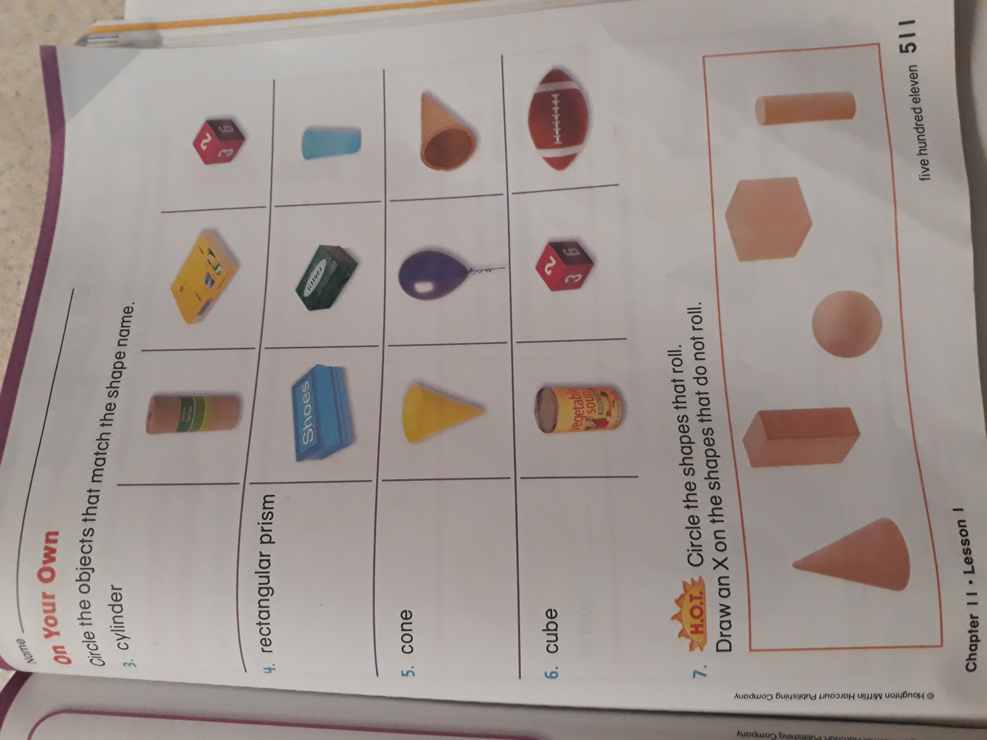

Slide 4
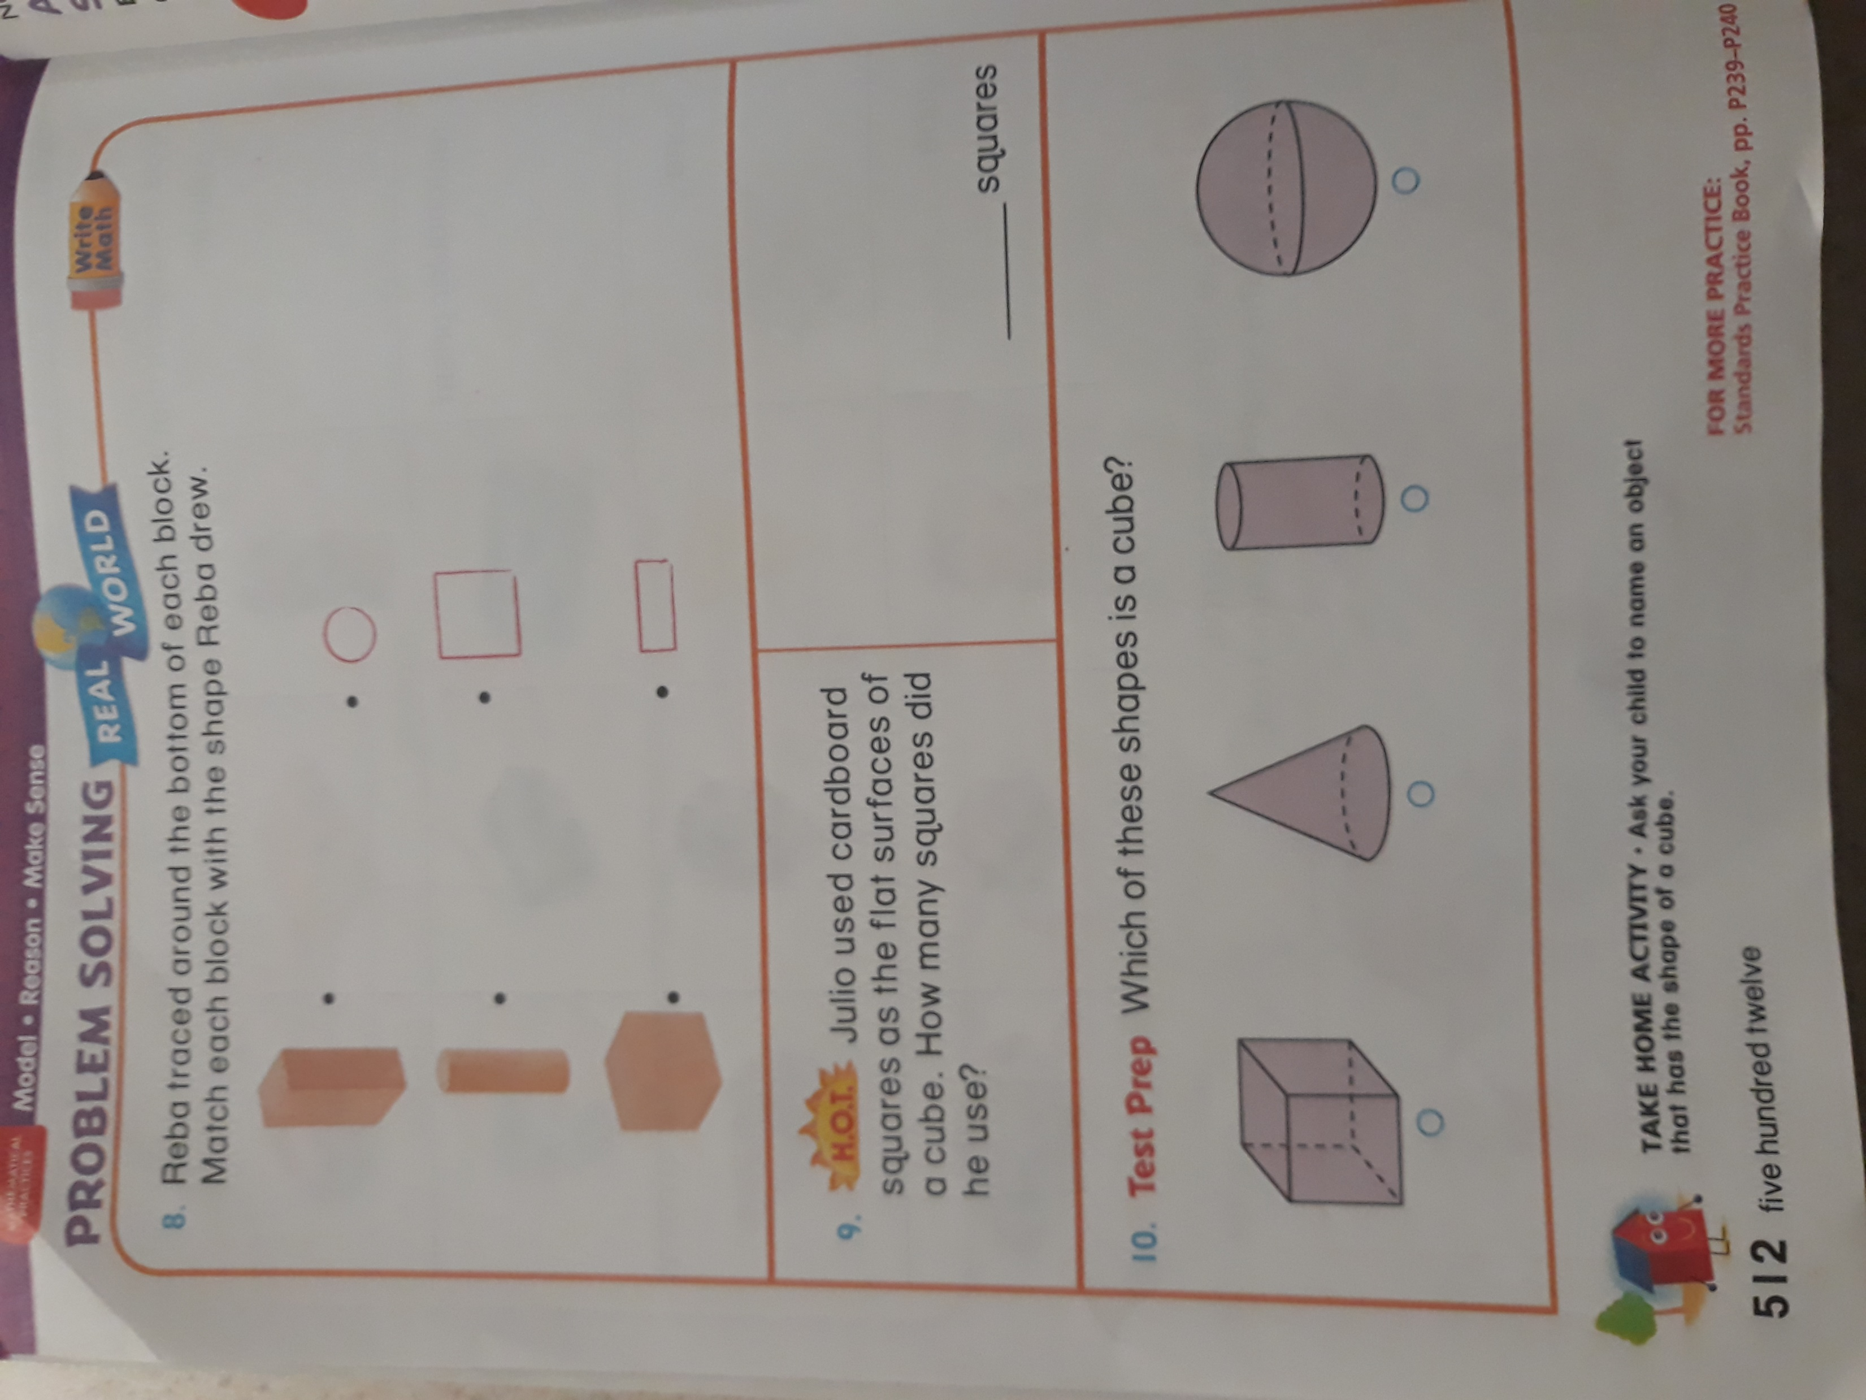

Slide 5
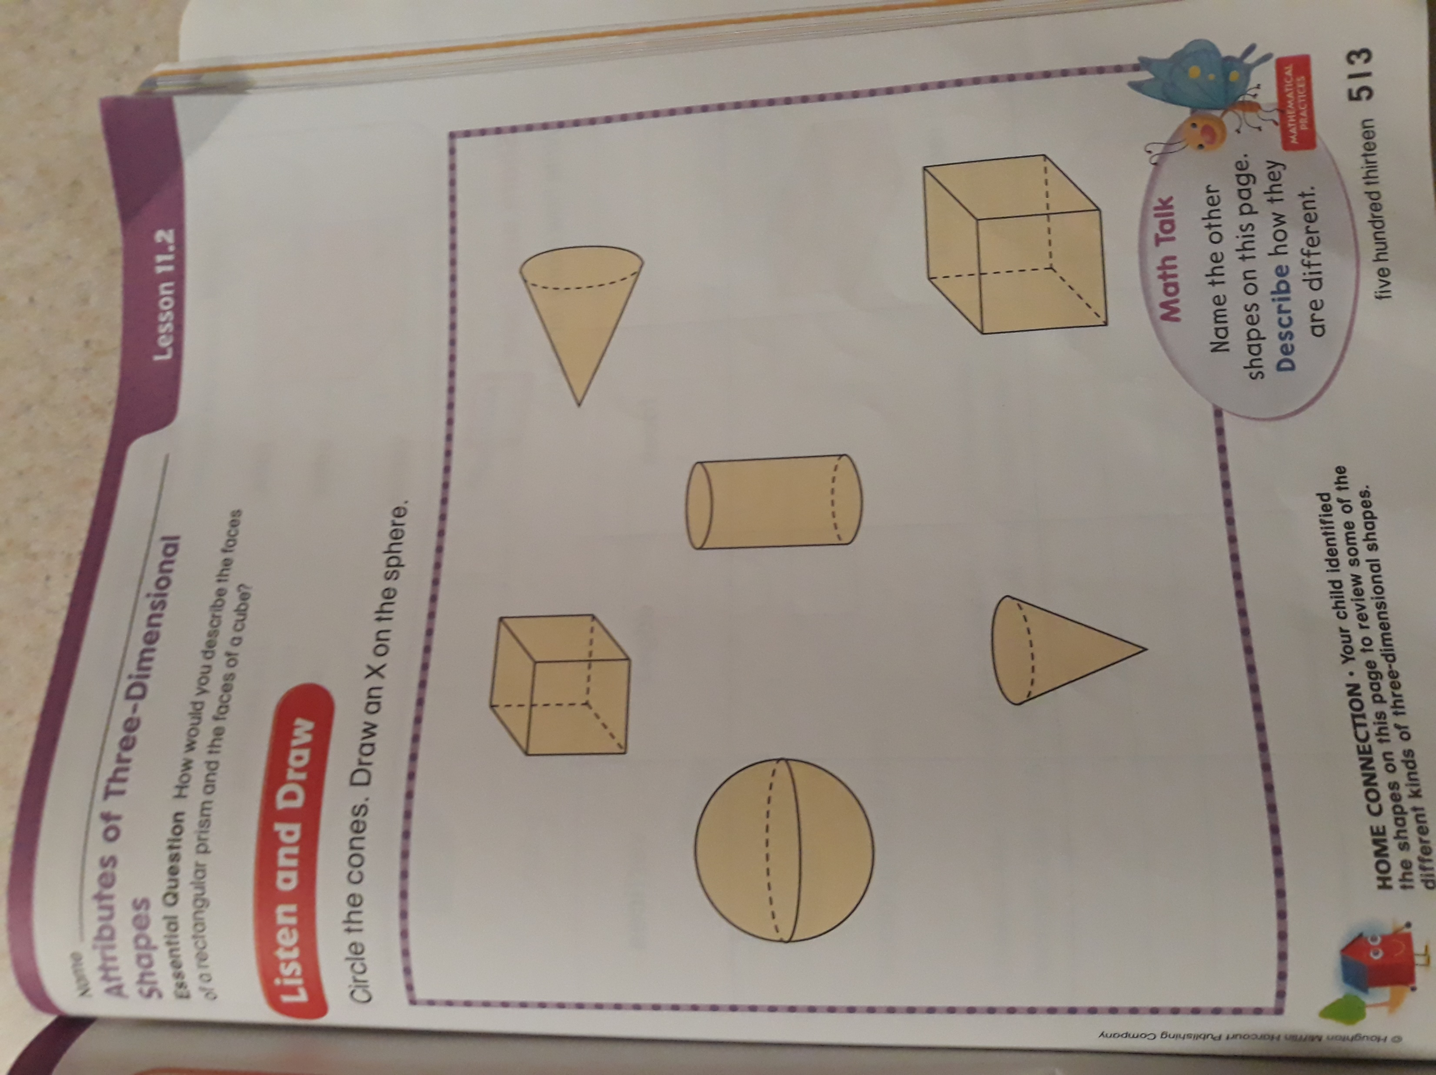

Slide 6
