Slide 1
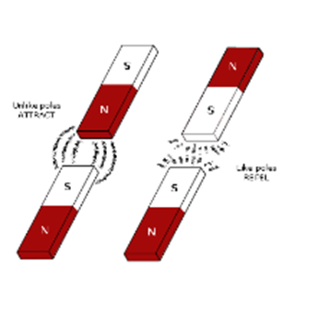
MAGNETIC PROPERTIES
SC.4.P.8.4 – Magnetic Properties
Investigate and describe that magnets can attract magnetic materials and attract and repel other magnets.
Notes:
Check out resources on the last slide you may want to use.

Slide 2


What is Magnetism?
Let’s Explore
What happens if you put together two magnets?
Do they become stronger together?
Experiment with magnets, a variety of sizes of magnetic objects, and write observations about strengths of different combinations of magnets.
Notes:
Engage with a quick activity. Give each group a pair of magnets to explore with.
Discuss their observations.

Slide 3

What is Magnetism?
Magnetism is the force of attraction or repulsion of a magnetic material due to the arrangement of its atoms.
Notes:
Explain: Ask essential question again. Listen to students’ ideas and explain.

Slide 4
What did you learn about
Magnetism?
Magnetism is a force.
Metals stick to magnets.
Magnets have different strengths.
Magnets have two poles:
north and south.
Like poles repel.
Opposite poles attract.
The force of magnetism can travel
through some objects.
Notes:
Explain
Students share reflections: What do you know about
magnetism now?

Slide 5
Exploring Magnetism Stations:
An Absolutely Magnetic Experience!
Station #1 Which Objects are Magnetic?
Station #2 Can you Fish?
Station #3 Can Magnets Float?
Station #4 Can you Play Marbles?
Station #5 Are all Magnets the Same?
Station #6 How can you Define a Magnetic Field?
Reflection:
What do you know about magnetism now?
Notes:
See the separate posted document ahead of time. You will need to gather materials and print out station cards.
Explore magnetic concepts through the stations. Explain: Students share what they did and learned from each station. Then they reflect: What do you know about
magnetism now? See next slide.

Slide 6
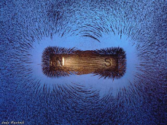
What are Magnet Basics?
Magnets are objects that produce magnetic fields and attract metals like iron, nickel and cobalt.
The magnetic field's lines of force exit the magnet from its north pole and enter its south pole.
Some magnets occur in nature, they are called natural magnets.
  Example: magnetite (also called lodestone)
Defined by: http://science.howstuffworks.com/magnet.htm
Notes:
Explain: play NBC video on Magnet Basic hyperlink

Slide 7
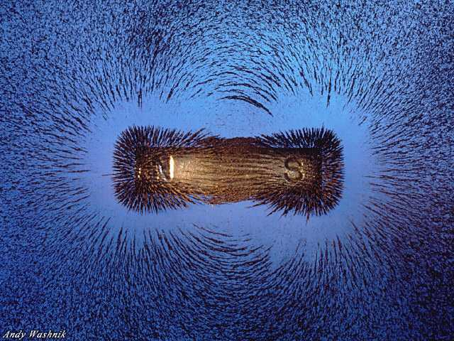
Field Lines Around a Magnet
Notes:
Explain: The magnetic field's lines of force exit the magnet from its north pole and enter its south pole.

Slide 8
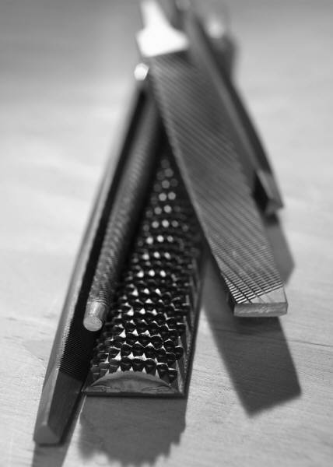
Magnets and Metals Investigation
www.acs.org/kids Science for Kids: Characteristics of Materials. Select Magnets and Metals.
Essential Question: What types of metals are attracted to a magnet?
Objectives:
-Classify metals based on their attraction to a magnet.
-Identify iron, nickel, and cobalt as magnetic
materials
Notes:
Explore and Extend:
investigate more concepts: www.acs.org/kids Science for Kids: Click on Characteristics of Materials. Select Magnets and Metals.
Also AIMS gr. 4 Physical Science: Magnets and Metals

Slide 9
Lab Reflection
What do you know about magnets now?
Are all objects affected by magnetism?
Not all objects are affected by the force of
  magnetism. ex. wood, glass, paper, plastic
  What are some metals affected by magnetism?
  Common metals affected by magnetism are iron, nickel, and
  cobalt
Is there something about magnets you are still
confused about?
Notes:
Explain/Evaluate: Students write responses in their notebooks.

Slide 10
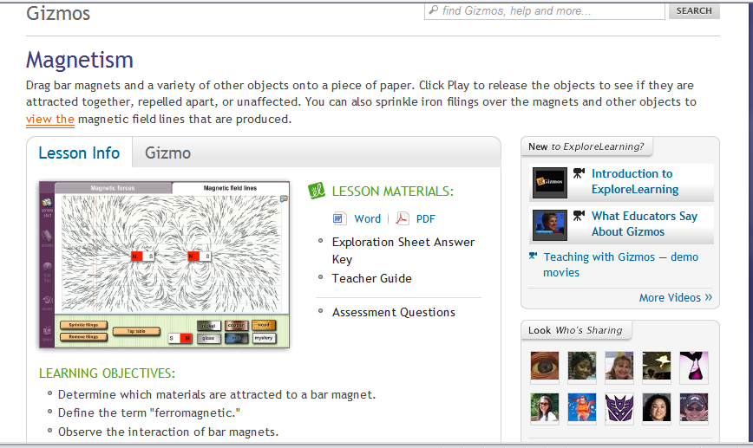
Gizmos
http://www.explorelearning.com/index.cfm?method=cResource.dspDetail&ResourceID=631
Notes:
Extend/Elaborate Lab

Slide 11
Review Quiz - True/False
Magnets are objects that produce an area of magnetic force called a magnetic field.
Magnets attract all types of metals.
Magnetism can attract magnetic objects or push them away.
Metals such as iron, nickel and cobalt are attracted to magnets.
Magnetic fields by themselves are visible to the human eye.
Adapted from: http://www.sciencekids.co.nz/sciencefacts/magnets.html
Notes:
Evaluate: True - False
Answer key:
True
False
True
True
False

Slide 12
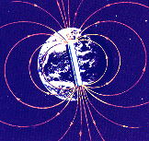
The Earth is a magnet:
It exerts magnetic forces and is surrounded by a
magnetic field that is strongest near the North and South magnetic poles.
Magnetic South Pole
Geographic North Pole
Geographic South Pole
Magnetic North Pole
Notes:
Extend/Elaborate

Slide 13
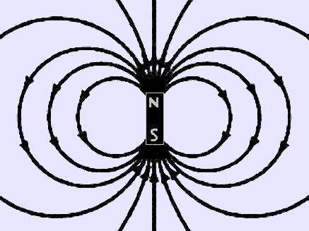
The ends of a magnet are where the magnetic effect is the strongest. These are called “poles.” Each magnet has 2 poles – 1 north, 1 south.
Notes:
Explain

Slide 14
What tool do we use to find direction using the Earth’s magnetic field?
A COMPASS
The needle of a compass always points toward the magnetic south pole.
We call this direction “North” (remember, opposites attract)
Notes:
Extend/Elaborate

Slide 15
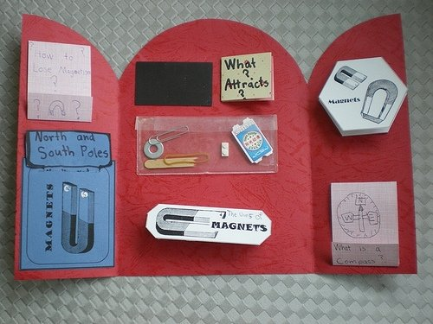
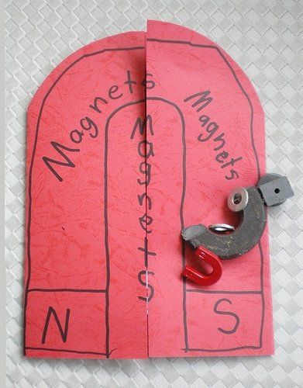
Foldables!
Notes:
Explain: Create a foldable using these key magnetism vocabulary. See next slides

Slide 16
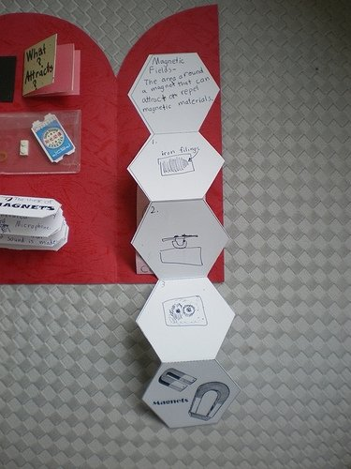
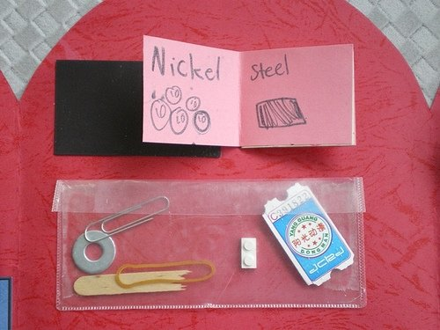
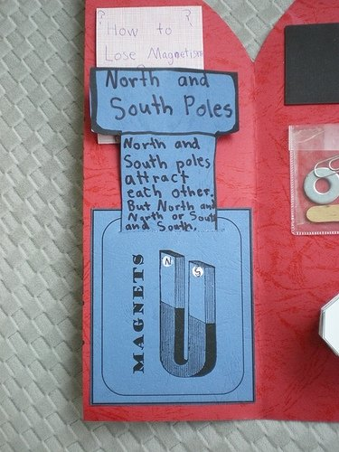
Notes:
Explain: Create a foldable using these key magnetism vocabulary. See next slide.

Slide 17
Vocabulary
Attract
To pull toward one another, as opposite poles of two magnets pull toward one another.
Force
A push or a pull.
Magnetism
A property of certain kinds of materials that causes them to attract iron or steel.
Repel
To push away, as similar poles of two magnets push away from one another.
Pole
Either of two opposing forces or parts, such as the poles of a magnet.
Notes:
Explain: Create a foldable using these key magnetism vocabulary. See previous slides for examples.

Slide 18

Writing in Science
Notes:
Extend/Elaborate

Slide 19
Additional Resource Links
Free Presentation in PowerPoint format: Magnetism: http://science.pppst.com/magnets.html
www.acs.org/kids Science for Kids: Click on Characteristics of Materials. Select Magnets and Metals.
Kitchen Magnet Game
http://www.fossweb.com/modules3-6/MagnetismandElectricity/activities/kitchen.html
AIMS Gr. 4 Physical Science: Magnets and Metals
http://studyjams.scholastic.com/studyjams/jams/science/energy-light-sound/magnetism.htm
http://www.ece.neu.edu/faculty/nian/mom/magic_of_magnetism.html

