Slide 1


Changes in Matter
SC.4.P.9.1

Slide 2
Common Board configuration
Benchmark:
SC.4.P.9.1
Identify some familiar changes in materials that result in other materials with different characteristics, such as decaying animal or plant matter, burning, rusting, and cooking.
Essential Question:
What are some changes in materials that result in other materials with different characteristics, such as decaying animal or plant matter, burning, rusting, and cooking?
  Home Learning:

Slide 3
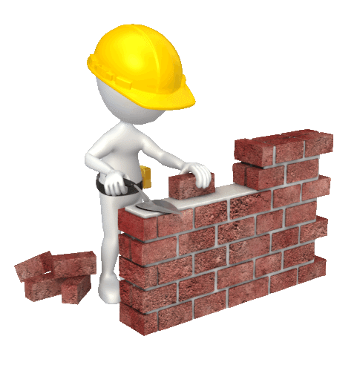
Word Wall
Words are placed on the bricks.
tarnish
size
decompose
shape
rust
color
gas

Slide 4
Chemical Changes
Chemical change occurs when one type of substance is changed into a new substance. There are many chemical changes that take place around us every day.

Slide 5
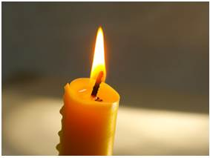
Burning
Burning is a chemical change. When a piece of paper burns, the paper and oxygen in the air combine to form ash and carbon dioxide. Anytime something burns, such as a candle or a camp fire, a chemical change is taking place.
Burning a candle changes the wax and the wick into soot, ash, and gases.

Slide 6
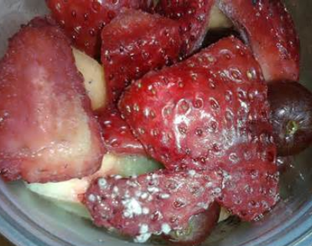
Decay
After an organism dies, the body of the organism will decay, and eventually the materials that made up the organism will be recycled back into the ecosystem. Decay is an example of a chemical change because it changes the material of an organism's body into new things.
For example, if a plant dies, the material that made up the plant will decay and become part of the soil.
Warmer temperatures help this process happen faster

Slide 7
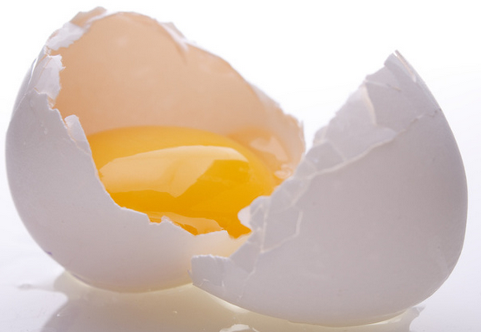
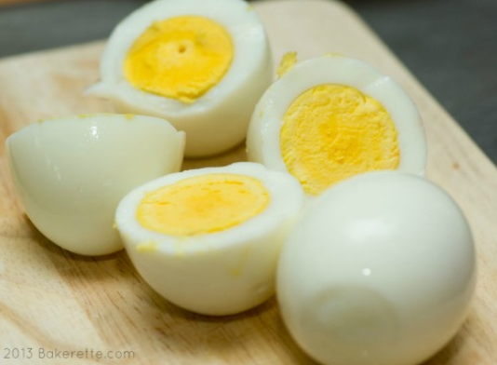
Cooking
During the process of cooking, materials often change into other materials with different characteristics. When this takes place, cooking is a chemical change. Chemical changes cannot usually be reversed. For example, it is not possible to "uncook" an egg.
An egg becomes stiff and white when it is cooked.
In the same way, the properties of a pancake are different than the properties of the uncooked mixture used to make the pancake. Cooking a pancake causes the mixture of flour, water, eggs, and oill to chemically combine

Slide 8
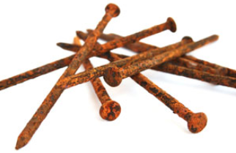
Rusting
Rust is an example of a chemical change. Rust forms when iron reacts with the oxygen in the air to make a new substance with new characteristics that are different from those of the original iron and oxygen. The process of rusting is a chemical change that can affect metals, rocks, and soils that contain iron.
For example, nails and screws can form rust when exposed to water in the atmosphere. Over time, rusting changes the iron in nails and screws from being shiny and smooth to reddish brown, rough, and crusty.

Slide 9
What are some signs of a chemical change that can be seen?
Signs or clues can include:
Change in odor
Change in color
Change in taste
Change in mass
Forming bubbles (giving off a gas)
Giving off smoke
Giving off light

Slide 10
Examples of chemical changes:
Corrosion of metal—when iron combines with oxygen in the air, rust forms
Gas bubbles— Baking soda combines with vinegar, carbon dioxide forms
A change in color (browning of fruit - decay) – an apple is peeled and reaction with oxygen in the air

Slide 11
Physical Change
A physical change is a change in the physical properties of matter. The matter changed in how it looks, but what it is made out of does not change.
A change that takes place when a substance changes in size, shape or form. The particles of matter do not change.
Chemical Changes
A chemical change is a change in the chemical properties of matter. A chemical change occurs when two or more kinds of matter combine to form a new substance with different properties.
A change that takes place when a substance is completely altered. The particles of matter do change.

Slide 12

What is a chemical change?
How is a chemical change different than a physical change?
How is heat involved in chemical changes?
How is heat involved in physical changes?

Slide 13
Answer: A chemical change produces substances that have new properties.
Answer: A physical change does not produce new substances like a chemical change does. It only changes physical properties.
Answer: Sometimes heating can cause chemical changes. Sometimes chemical changes give off heat.
Answer: Sometimes adding heat to matter can change its state - when enough heat is added to it can cause melting or if heat is taken away it can cause freezing of the matter.

Slide 14
Example of Change
Water boiling into steam
An ice cream melting
A bicycle rusting in the rain
A banana turning brown
Tearing paper into pieces
A candle wick burning
Water freezing into ice
A carton of milk going sour
A loaf of bread cut into
slices
Burning toast in the toaster
Physical or Chemical
1.
2.
3.
4.
5.
6.
7.
8
9.
10.
Cite evidence

Slide 15
Physical and Chemical Change Resources:
Free Brain POP: Matter Changing Property Changes
Scholastic Study Jams:
Physical & Chemical Changes of Matter
CHEM4KIDS:
Changing States of Matter Chemical Reactions
PBS Learning Media:
http://wlrn.pbslearningmedia.org/resource/idptv11.sci.phys.matter.d4ksow/states-of-water/

