Slide 1
Math Equal Part
of a whole

Slide 2
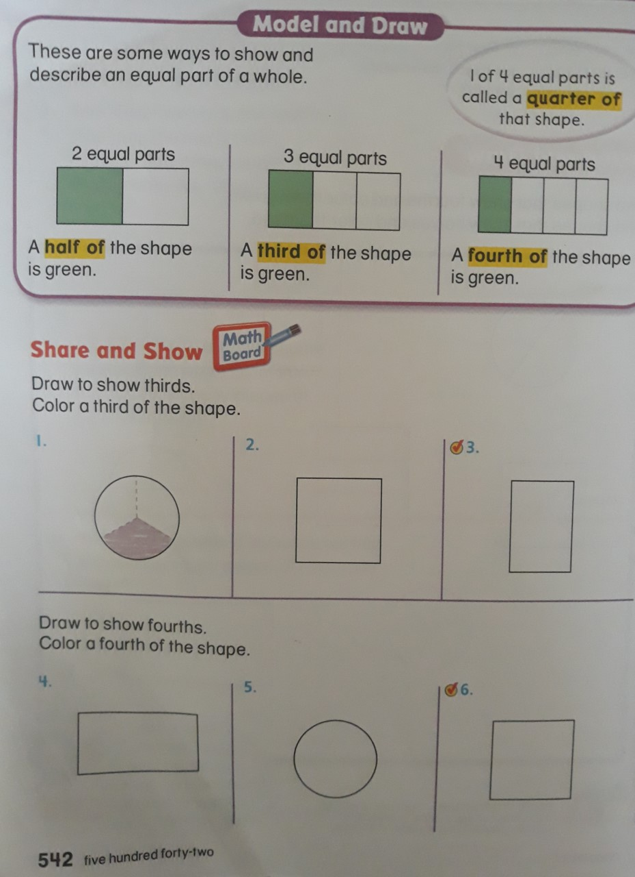

Slide 3
