Slide 1

Recount Stories and central message
First Grade and Second Grade
Virtual Learning

Slide 2



Standards
LAFS.1.RL.1.2 Retell stories, including key details, and demonstrate understanding of their central message or lesson.
LAFS.2.RL.1.2 Recount stories, including fables and folktales from diverse cultures, and determine their central message, lesson, or moral.

Slide 3

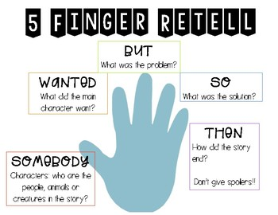
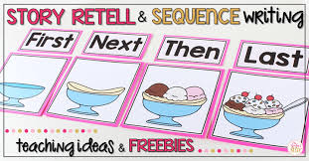
Recount Stories Use key details from the text:
Characters
Setting
Events

Slide 4


Include details:
Characters
Setting
Events

Slide 5
Include details:
Characters
Setting
Events

Slide 6

Central Message
What is the problem?
What does the character do about the problem?
What does the character learn?
What does the author want you to learn?
The big idea that the author is trying to teach you.
Example:
Book: Interrupting Chicken
Central Message: Do not interrupt others while they are talking.

Slide 7
Now it is our turn! Read a fairy tale: - Recount the story - Find the central message

