Slide 1
Forms of Energy

Slide 2
Objective
Investigate and describe some basic forms of energy, including light, heat, sound, electrical, and mechanical.

Slide 3
Essential Question
What are the basic forms of energy?

Slide 4
Forms of Energy
Energy - is the ability to do work. Energy can make things move or change and can be transferred from one form to another and from one object to another.
Energy comes in many different forms, including:
mechanical energy
electrical energy
heat energy
light energy
sound energy (acoustic energy)

Slide 5
Mechanical Energy
Mechanical energy - is the energy that an object has due to its motion or its position.
These two types of energy are called
Potential (energy of position) – stored energy. Energy that is not causing changes now but could cause changes.
Kinetic (energy of motion) – energy due to motion

Slide 6

Potential Energy
(energy of position)
Potential Energy (energy of position)-is energy that in not causing any changes now but could cause changes in the future.
Gravitational potential energy- a car sitting on a hill has gravitational potential energy. When gravity pulls the car down the hill that energy changes from potential energy to kinetic energy (energy of motion).
Elastic potential energy-is the energy of objects that can bend or stretch. When a rubber band is stretched that is potential energy (energy of position) when the rubber band is released it is kinetic energy (energy of motion)

Slide 7

Energy | is the ability to do work. Energy can come in many different forms but there are six basic forms of energy: mechanical energy electrical energy heat energy light energy sound energy
Mechanical energy | is the energy that an object has due to its motion or its position. Potential (energy of position) – energy not causing any changes but could cause changes. Kinetic (energy of motion) – energy due to motion.

Slide 8

Electrical Energy
Electrical energy - comes from the movement of charged particles, such as electrons. This kind of energy is also referred to as electricity.
Electrical energy is very important because machines can change electricity into many other forms of energy. Electrical energy can be converted into heat, light, sound, or mechanical energy. Electricity travels through conducting materials, such as wires. Electrical energy can be changed into other kinds of energy, including:
light energy when electrical energy causes the metal wire in a light bulb to glow
sound energy when electrical energy causes speakers in a radio to vibrate

Slide 9
Give two examples of electrical energy.
You can not use lights.

Slide 10
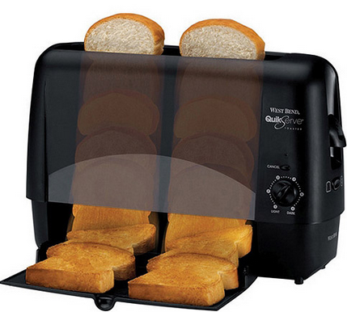
Heat Energy
Heat or thermal energy - is how hot or cold an object is. Heat energy is transferred from warmer objects to colder objects. Heat energy can be produced from other forms of energy.
The temperature of an object is related to how much thermal energy that an object has.
Examples of heat energy include: when things rub together they create heat because of friction, when wood or other fuels are burned to produce heat, when electric energy is converted to heat in appliances, such as hair dryers or toaster

Slide 11

Cornell Notes
Energy | is the ability to do work. Energy can come in many different forms but there are six basic forms of energy: mechanical energy electrical energy heat energy light energy sound energy
Mechanical energy | is the energy that an object has due to its motion or its position. Potential (energy of position) – energy not causing any changes but could cause changes. Kinetic (energy of motion) – energy due to motion.
Electrical energy | comes from the movement of charged particles, such as electrons
Heat or thermal energy | is how hot or cold an object is. Heat energy is transferred from warmer objects to colder objects

Slide 12
Give two examples of heat energy.
You can not use stove or sun.

Slide 13



Light Energy
Light energy - is a type of wave energy which can be sensed by the eyes. Other types of energy can produce light energy. For example, when metal gets very hot, it glows.
Light energy produced by the Sun is called solar energy. Light energy always travels away from its source in a straight line until it strikes a different material.

Slide 14
Give two examples of light energy.
You can not use light bulb or sun.

Slide 15
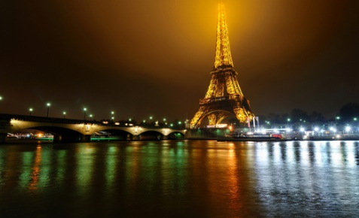

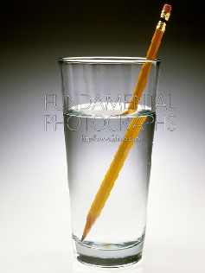
Light Energy
Light travels in a straight line until it strikes an object or travels from one medium to another.
Light can be:
Reflect – the bouncing back of light from a surface.
Refract – the bending of light as it moves through one material.
Absorb – when light is absorbed by an object.
Things that give off light often also give off heat:

Slide 16
Explain a real world example of refraction.

Slide 17
Cornell Notes
Energy | is the ability to do work. Energy can come in many different forms but there are six basic forms of energy: mechanical energy electrical energy heat energy light energy sound energy mechanical energy
Mechanical energy | is the energy that an object has due to its motion or its position. Potential (energy of position) – energy not causing any changes but could cause changes. Kinetic (energy of motion) – energy due to motion.
Electrical energy | comes from the movement of charged particles, such as electrons
Heat or thermal energy | is how hot or cold an object is. Heat energy is transferred from warmer objects to colder objects
Light energy | is a type of wave energy which can be sensed by the eyes Light can: Reflect – the bouncing back of light from a surface. Refract – the bending of light as it moves through one material. Absorb – when light is absorbed by an object.

Slide 18
Sound Energy
Sound energy - is the energy of sound waves as they travel. Sound is created by the vibration of an object. Sound energy can be produced by other forms of energy, such as: mechanical energy, when drums are played electrical energy, when a radio is turned on The speed of a sound wave depends on what the wave is traveling through. Sound travels more quickly through a solid than through a liquid or through air. Sound waves cannot travel through a vacuum such as outer space because there is nothing there for the waves to travel through.

Slide 19
Give two examples of sound energy.
You can not use instruments or radio.

Slide 20
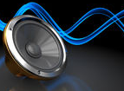
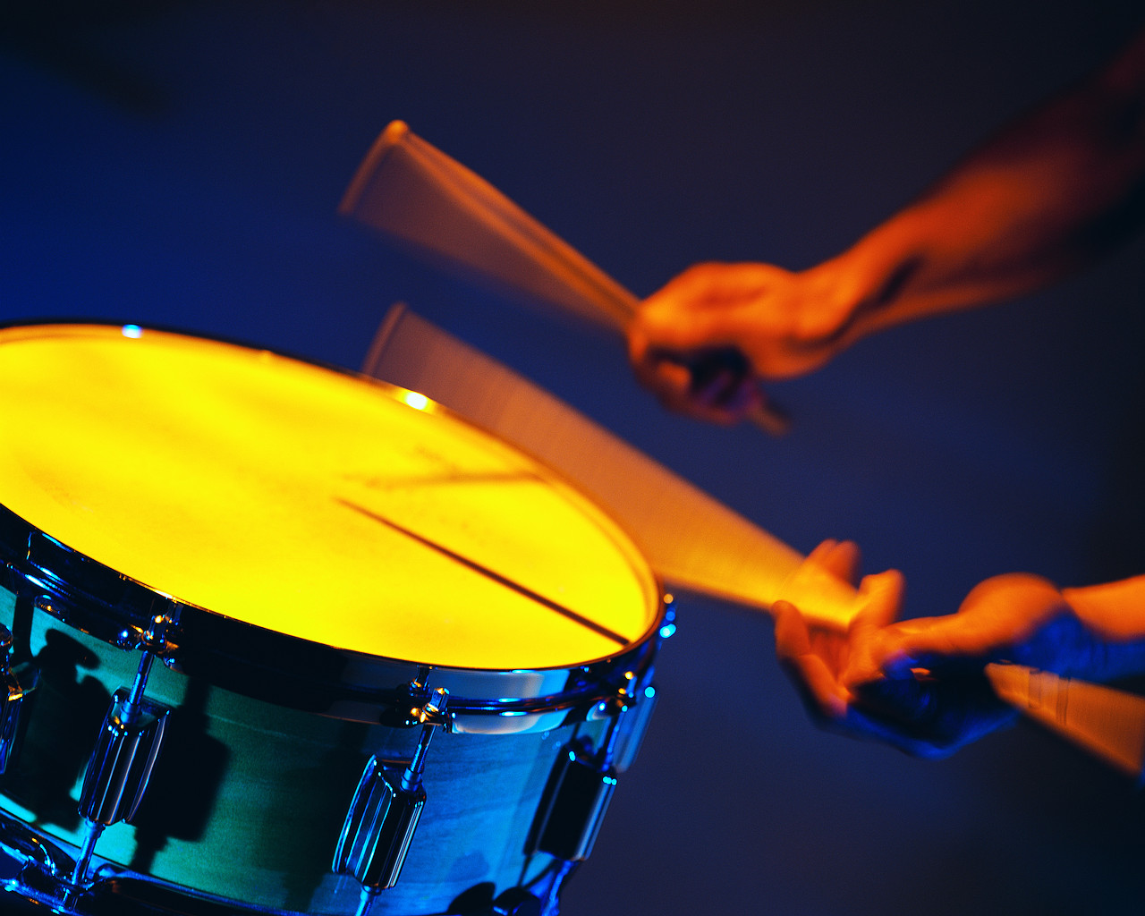

Slide 21
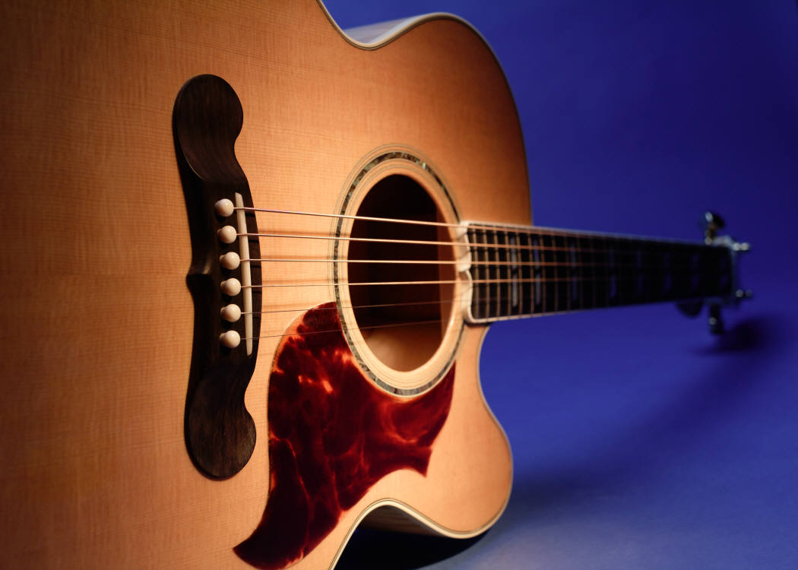
Pitch
Pitch - is determined by the speed of its vibrations. Faster vibrations result in a higher pitch and slower vibrations result in a lower pitch. Different musical notes have different pitches.
Tightness (or tension) can affect pitch.
Imagine two strings of the same length: one string is pulled tightly and the other string is loose. If both strings are plucked, then the tight string will produce a higher-pitched sound than the loose string because the tight string will vibrate faster.
Size, such as the length or thickness of a string, can affect pitch.
If two strings are pulled to the same tightness, but one is longer than the other, the shorter string will make the higher pitched sound because it will make faster vibrations.
Thicker strings will make lower pitched sounds than thinner strings of the same length with the same tension.

Slide 22
Cornell Notes
Light energy | is a type of wave energy which can be sensed by the eyes Light can: Reflect – the bouncing back of light from a surface. Refract – the bending of light as it moves through one material. Absorb – when light is absorbed by an object.
Sound energy | is the energy of sound waves as they travel. Pitch – is how high or low the sound is. Pitch is determined by the speed of its vibrations. Faster vibrations result in a higher pitch and slower vibrations result in a lower pitch
Notes:
Work with a partner to complete Cornell notes for the different forms of energy.

Slide 23
Independent Practice
Forms of Energy | Examples

