Slide 1
Element Baby Book Project
Procedure and Example

Slide 2
Introduction
In this project you will adopt an element from the periodic table.
As the proud new parent of your element, you will create a baby book (using PowerPoint) to remember each stage of your element’s life.
This counts as a project grade. Pay special attention to the required details so you don’t lose points.

Slide 3
How and When?
When:
Introduction 11/4 (A) & 11/4 (B)
Class work – 11/10 (A) – 11/12 (B)*
Final Project due Date:
Thursday, 11/19 (A) & Friday, 11/20 (B)
Option presentation date:
Monday, 11/23 & Tuesday, 11/24

Slide 4
Process
Use the Internet (Google search, etc.) to research the element name.
avoid Wikipedia
During this process remember to include:
Color
Neatness
Check spelling and grammar
Fill the pages
Be creative!!!

Slide 5
Cover Page
Name of element
Picture of the element (in everyday use)
Your name
Decorative cover

Slide 6
Cover page (poor) example
LITHIUM
FROM: Mr. P

Slide 7
Better EXAMPLE
LITHIUM
From Mr. P

Slide 8
Birth Certificate 5 pts.
Name (name of the element) Lithium
Nickname (symbol) Li
Birth Date (date element discovered) 1817
Birth Weight (atomic Mass) 6.941 amu
Birth Height (atomic number) 3
Race (type of element- metal, non-metal, metalloid) metal
Doctor (discoverer) Johan A. Arfvedson
Gender (state of matter at room temperature) solid
Place of birth (country of discovery) Sweden
Personality (boiling point & melting point) 1347 c/108.54c
Signature of Parent (that’s you!)
Make it look professional (border, seal of approval, etc...)

Slide 9
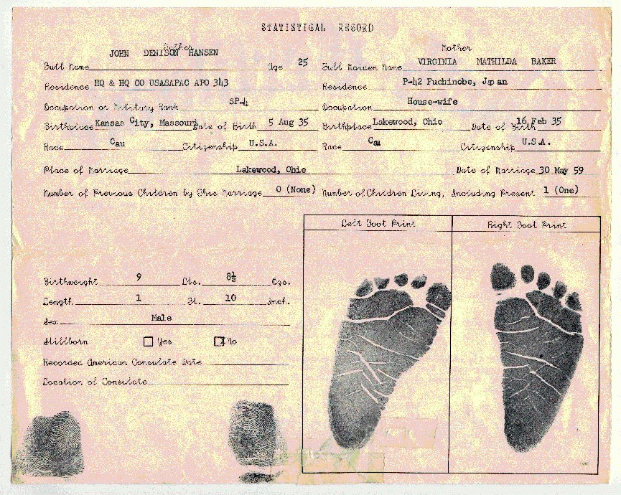
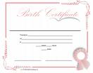
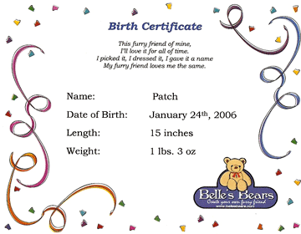
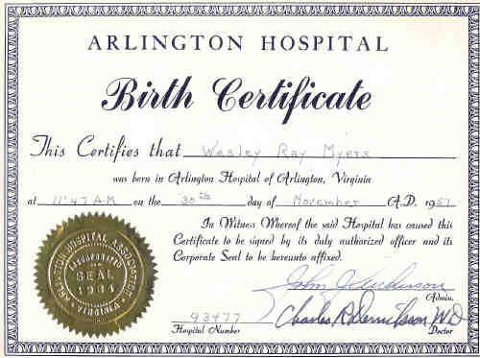
Birth Certificate examples Find a style you like and copy it with your element’s info. (Google images) or type it in yourself to a Word document.

Slide 10
BIRTH CERTIFICATE
This is to certify that
LITHIUM
Birth Weight : 6.941 amu Birth Height: 3
Race: Metal Gender: Solid Nickname: Li
Personality: Boiling Point 1347C, Melting Point 108.54C
Was born in the year of 1817
in the country of Sweden.
Physician in attendance was Johan A. Arfvedson
Signature of Parent: Mr. T. Lithium Element

Slide 11
Pronunciation Rebus & Poem- 2 pts.
Include a pronunciation rebus to explain how your element’s name is pronounced
Ex.

Slide 12
My Favorite Story/Poem/Song 3 pts
Create a story, poem or song about your element’s life.
It may be funny and should be appropriate but MUST be applicable to your elements uses or behaviors.
It must contain at least 5-8 sentences (for the story) or 5- 8 lines (for the poem or song).

Slide 13
POEM
Lightweight
In petalite
BatTeries
JoHan Arfvedson
Reactive wIth water
Mined Under ground
M etal

Slide 14
The Story of Me
For a baby, I’m actually really old. I’ve actually been around almost since the Big Bang. You can usually find baby elements like me paired up in a compound, because I’m highly reactive. I’m reactive because I love to share my single electron and become a cation. I’m a giver, that’s what I do! I’m an old softie, so soft that you could cut me with a knife, but please don’t do that because I oxidize quickly. You can usually find me around the rocks (in the Earth’s crust) or near the oceans. Babies like me don’t come along every day, because I’m only the 25th most abundant element. I am really popular though, because of my usefulness in the medical field, batteries used in electronics, and as a lubricant for manufacturing!

Slide 15
Baby Picture 2.5 pts.
Create a picture of a baby
Make sure your baby also has a body!
The baby needs to have a drawing of your element’s atomic structure on their shirt (use your handout for help)
Be sure to label your element and list its protons, neutrons & electrons in the correct amounts.

Slide 16
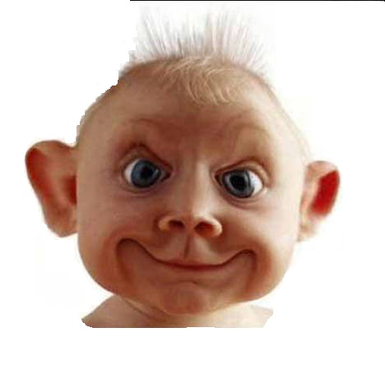
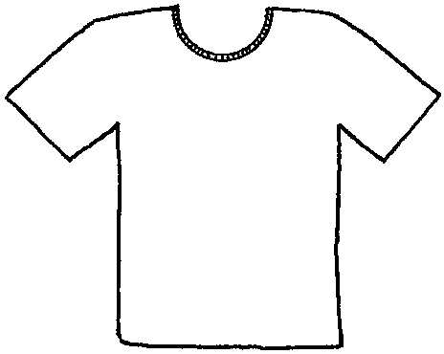
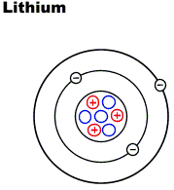
Protons 3
Neutrons 4
Electrons 3

Slide 17
When I Grow Up 2.5 pts.
In a paragraph of 8 sentences or more, explain the following:
Career choice (what is your element going to be used for)
A picture of the career (use a different picture than the one used for the cover)
Explain it in the 1st person

Slide 18
Lithium
When I grow up I want to be used in Lithium-ion batteries. I live in Bolivia now and I am waiting for the scientists to mine me and bring me to Europe where I will be used in hybrid and electric cars.
In the past, Lithium was used for mood stabilizing drugs and thermonuclear weapons. Now Blackeberrys, electronic devices and the automotive industry need my mineral more.
Lithium is lighter than nickel and stores more energy. Governments are fighting to purchase me now. I hope to go to Mitsubishi and be used in one of their electric cars some day.

Slide 19
Family Tree 2.5 pts.
Create a family tree to place the following information.
Family name (name of the group it belongs to alkali metals, halogens, etc.)
Brothers and sisters(names of the other elements in the group)

Slide 20
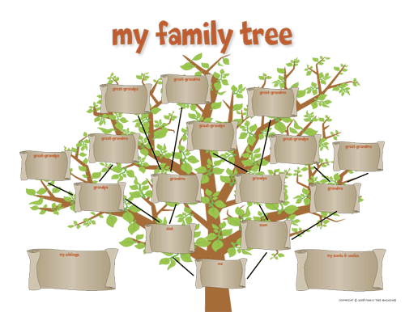
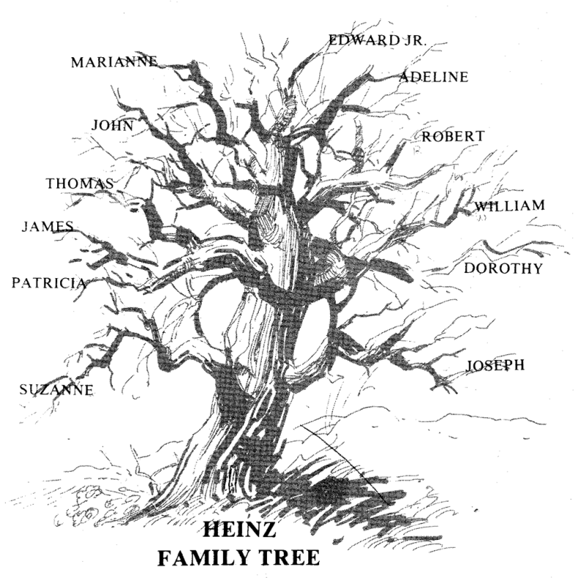
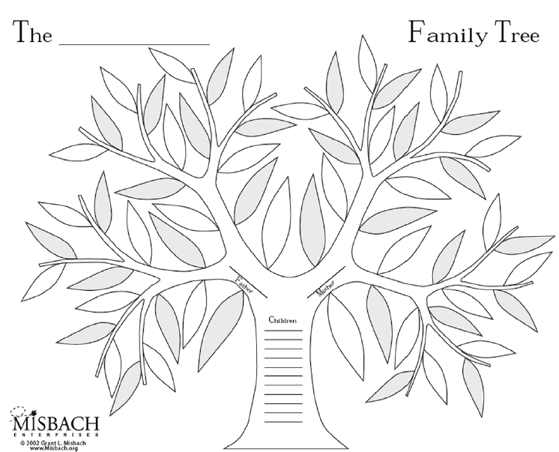
Family Tree examples

Slide 21
The Alkali Metal Family, Group I
Hydrogen
Sodium
Potassium
Rubidium
Cesium
Francium
Lithium

Slide 22
Address- 1.25 pts
Create an address using the following information:
Period (on periodic table of elements)
Discoverer’s last name
Drive, street, avenue, court, lane, etc.
EX. 2 Arfwedson St.

Slide 23
Physical Description (props)- 1.25 pts
Describe physical properties of your element
Malleability
Ductility
Conductivity
Color
State of matter
Etc.

Slide 24
Bohr Model (3.75 points)
Include the Bohr Model of your element
Electrons, protons and neutrons

