Slide 1
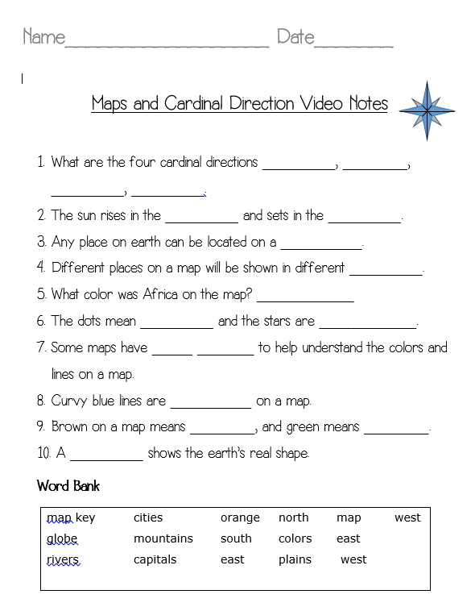

Slide 2
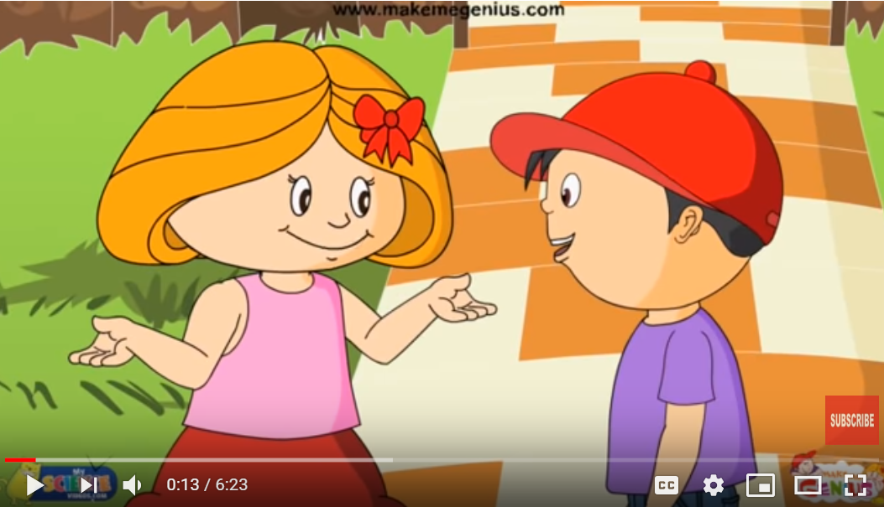
This worksheet is to be use with the video linked below.
https://youtu.be/5IpdjyD_uPo

Slide 3


Copyright © 2018 Jamala Fusilier
All rights reserved by author.
Permission to copy for classroom use only.
Electronic distribution limited to classroom use only.
Credits:
www.makemegenius.com

